Slide 1

GEORGIA NONPROFIT EMPLOYEE
BENEFITS STUDY
EMPLOYEE BENEFITS, JOB SATISFACTION, AND DEMOGRAPHICS
Sponsored by the Interdisciplinary Alliance for Nonprofits at the University of Georgia
Prepared by Gabe Kidman and Rebecca Nesbit, Ph.D.
October 30, 2024

Slide 2

Background
Before 2020 (and COVID-19) the voluntary turnover rate for nonprofit organizations was around 13-14% (Nonprofit HR, 2016).
Since 2020, the voluntary turnover rate has consistently been around 19%, with smaller nonprofits experiencing turnover rates up to 25% (Cerini, 2024; Smith, 2023)
That is 58.3% higher than the private sector’s voluntary turnover rate of 12% (Cerini, 2024)
More information on how to retain and attract nonprofit employees is needed.
Notes:
Before Covid the turnover rate was similar to the for-profit sector
Since COVID it is much higher (Great Resignation)
Turnover is problematic. It is disruptive, time consuming and expensive.

Slide 3
Objective
Understand the current trends in benefit packages offered by Georgia nonprofits (large and small).
Identify how Georgia nonprofit employees feel about their benefits.
Explore the top reasons why employees would consider leaving their current position.
Discuss overall levels of employee job and benefits satisfaction and levels of burnout.

Slide 4

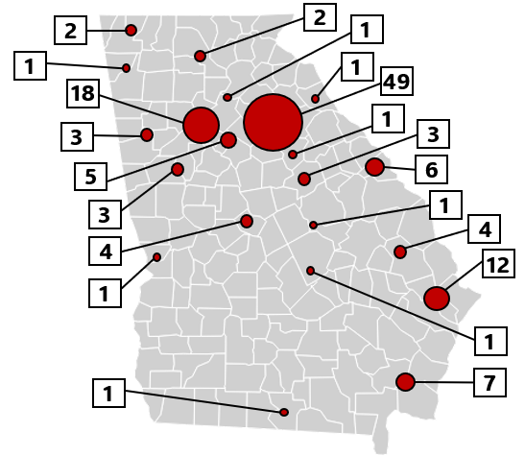
Methodology
The data were collected through a thirty-seven-question online survey using empirically tested scales.
Researchers used snowball sampling starting with the IANP listserv.
Data collection occurred in Spring 2024.
Final sample size is 260 employee responses from 126 unique organizations.
Sample includes 63 large and 63 small organizations (annual budget of $1,000,000).
Forty-percent of the organizations are from the greater Athens area.
Notes:
Athens/NE Georgia bias. We do not claim it to be generalizable to all GA nonprofits.
However, this is a unique study with a robust data set that we can use as a foundation for future studies.
We understand that nonprofit organizations vary in size, capacity, longevity, and funding predictability, but…
We hope you will be able to make meaningful comparisons with your own organizations.
3. Organization:
Large and small was based on annual budgets of 1 million.
46% mission is in human service
One third have fewer than 5 employees
48% get funding from government grants and contracts
46% are over 30 years old
4. Individual
68% white and 25% black
86.5% are female
52% have children in the home

Slide 5






PART 1: Benefits
Notes:
For this first part we will be looking at the benefits that organizations offer.
In the study we have 126 organizations in total to keep in mind.

Slide 6
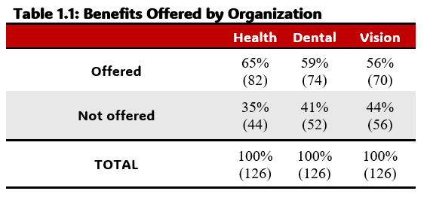
PART 1: Offered Benefits
Notes:
1. Overall….(read percentage values)…but when we take into account size….

Slide 7
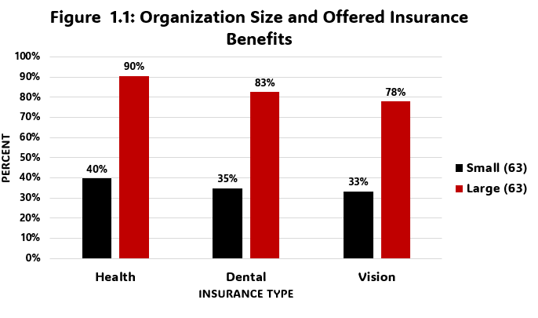
PART 1: Offered Benefits
Notes:
1. We find that smaller organizations are 50% less likely to offer benefits.

Slide 8
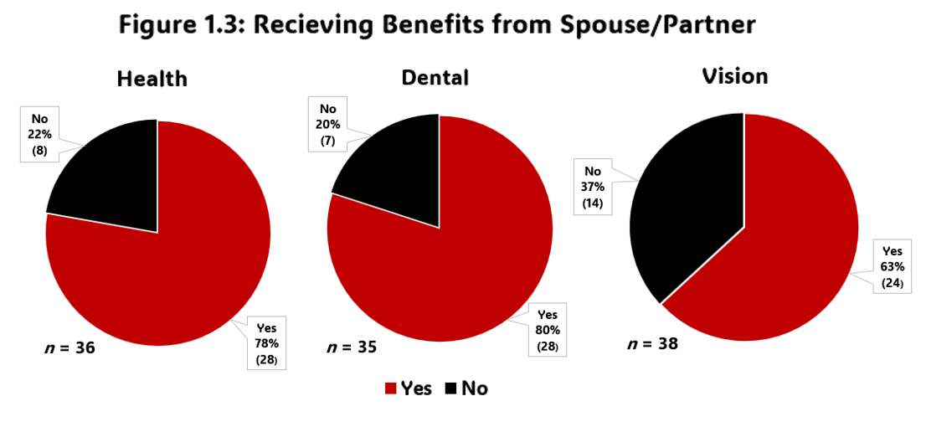
PART 1: Benefits from Partner
Notes:
Additionally, even when organizations offer the benefits many employees may not use them….
For example, out of the 172 employees that are married or living with a partner, and that are offered benefits from their organization, only…(read percentages of “YES”).
For those that are single, they report opting out in order to use Medicare, a better plan from another job, and their parents insurance.

Slide 9
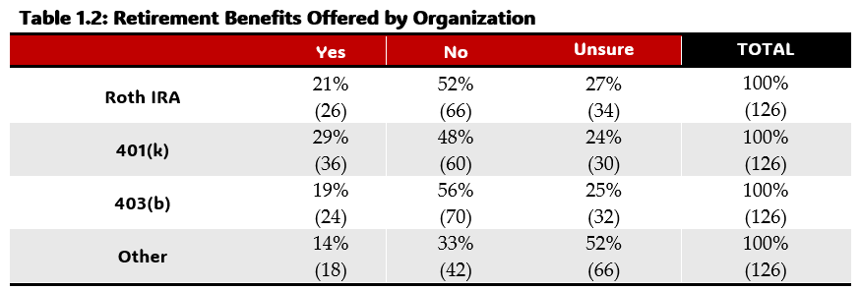
PART 1: Retirement Benefits
Notes:
When looking at retirement benefits we find that not many organizations over benefits….
…(read the statistics)
Additionally, though we are not sure why this is the case, we find it interesting that roughly ¼ report being “unsure”

Slide 10
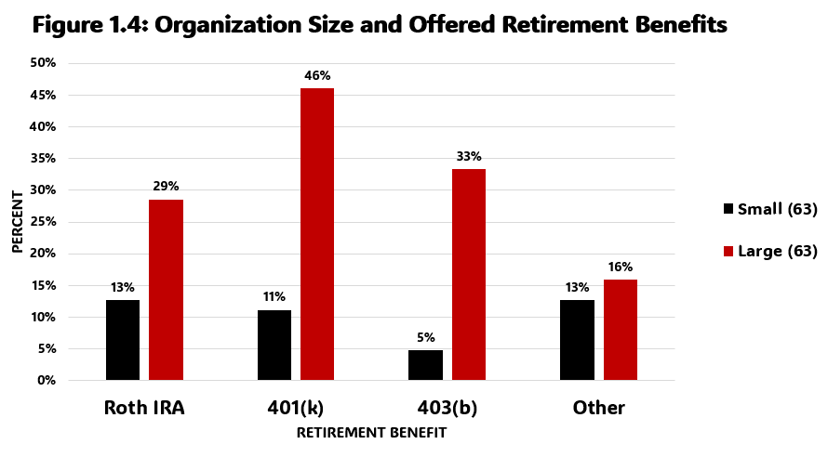
PART 1: Retirement Benefits
Notes:
When we account for organization size we see that the disparity between large and small is dramatic.
5 – 13% of the small organizations offer some kind of retirement benefit.

Slide 11
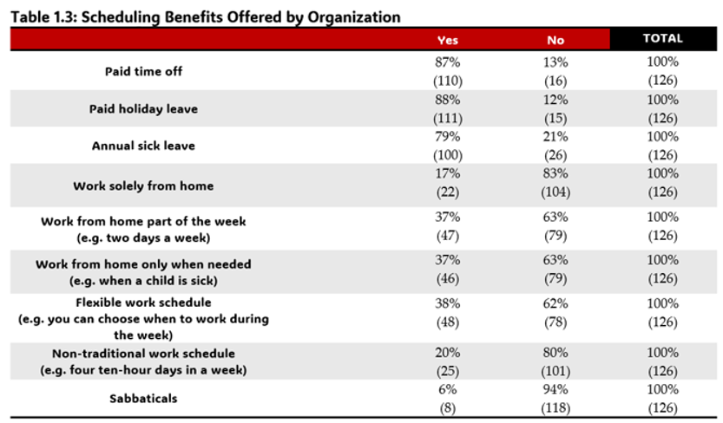
PART 1: Scheduling Benefits
Notes:
Moving to scheduling benefits we find some promising results.
Overall, roughly 80 to 90% of organizations in the study offer paid time off and holiday and sick leave.
Additionally we find some interesting results when break the data down into small and large organizations…

Slide 12
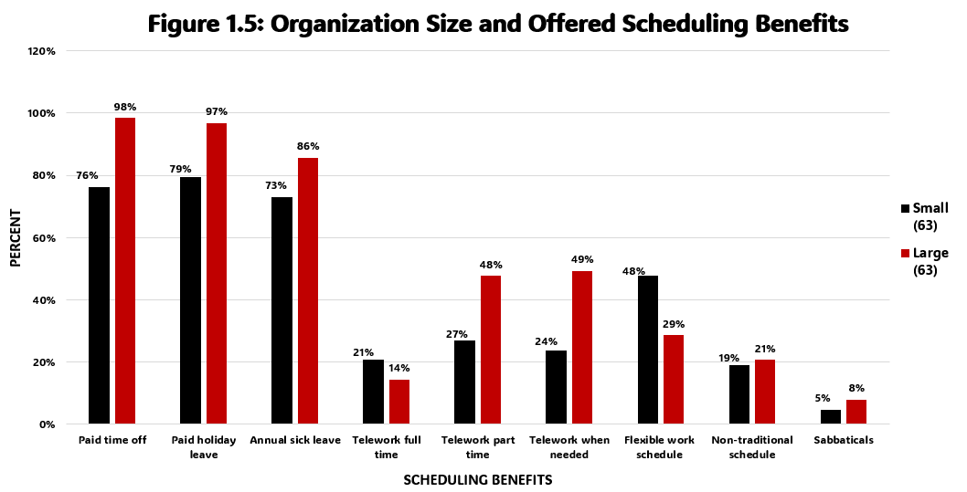
PART 1: Scheduling Benefits
Notes:
Unlike previous benefits, small organizations are doing a great job in keeping up with scheduling benefits.
Such that when looking at full time telework and flexible work hours, they outpace the larger organizations.
A possible reason could be that they utilize scheduling benefits in order to make up for the lack of other benefits.
They might find that employees are fine with less benefits for more flexibility and autonomy of their schedule.

Slide 13
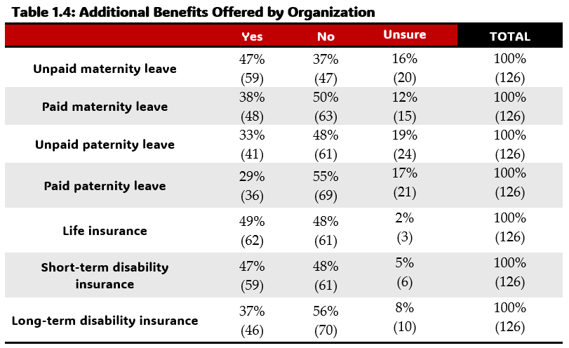
PART 1: Additional Benefits
Notes:
Beyond scheduling benefits we find that more organizations offer unpaid maternity leave than paid maternity leave…(read percentages)
Additionally, around 50% of the organizations offer life and disability insurance.

Slide 14
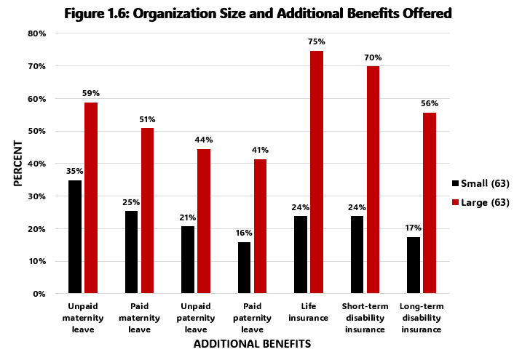
PART 1: Additional Benefits
Notes:
1. This is where, as before, we find the expected pattern of smaller organizations offering much less benefits than the larger ones.

Slide 15
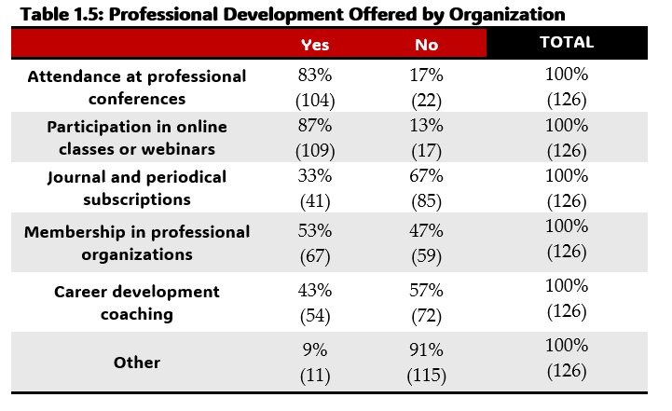
PART 1: Professional Development
Notes:
A final exciting discovery is that Georgia nonprofits invest in the professional development of their employees.
We found that…(read percentages)

Slide 16
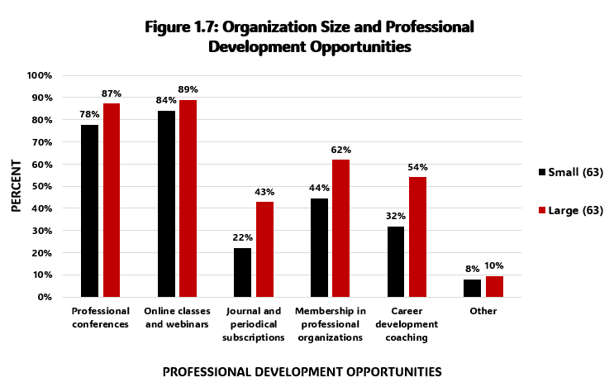
PART 1: Professional Development
Notes:
1. Even more encouraging is that as with scheduling benefits, small nonprofits proficiently keep up with large nonprofits.
2. This may be another area where in the absence of small organizations being able to offer health care, they show their investment into their employees through professional development opportunities

Slide 17






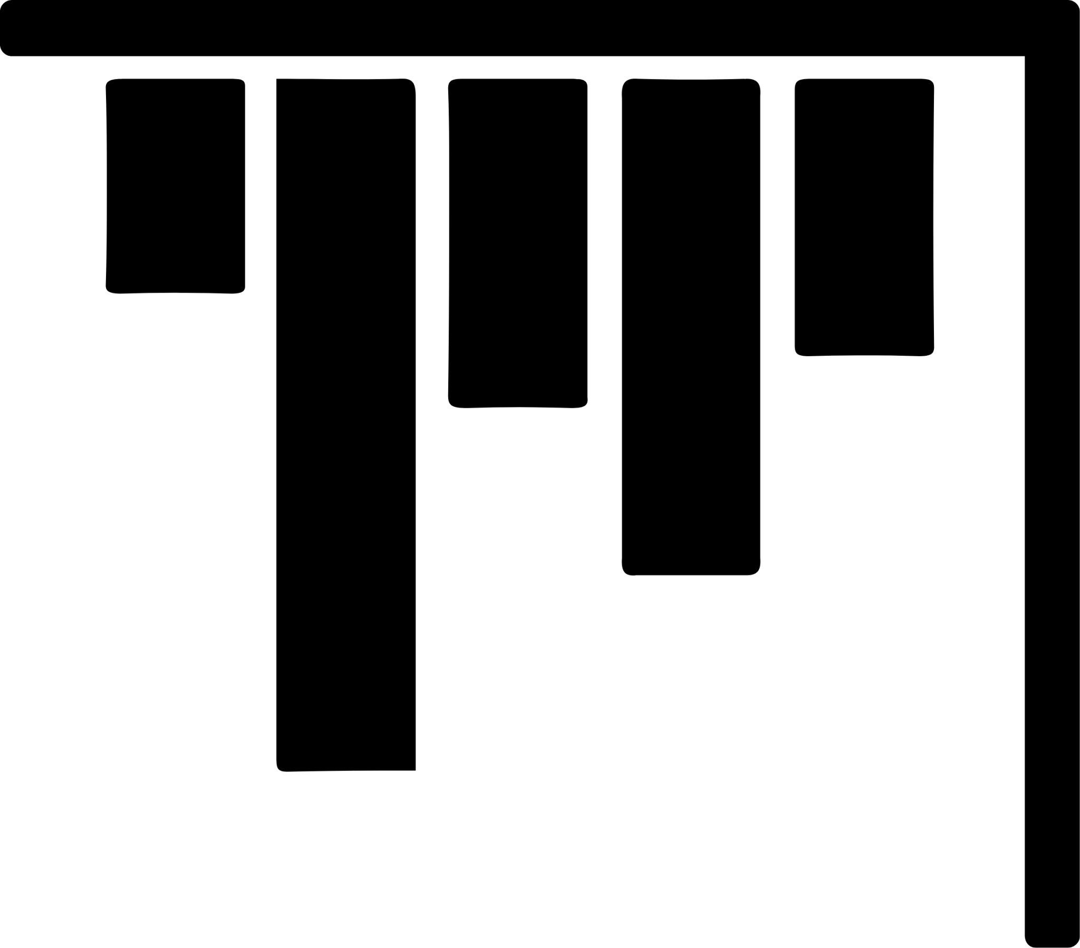

PART 2: Employee Satisfaction
Notes:
We will now be moving to looking at what employees think of the benefits being offered.
We are now moving to the employee perspective with the denominator changing to the 260 employees.

Slide 18
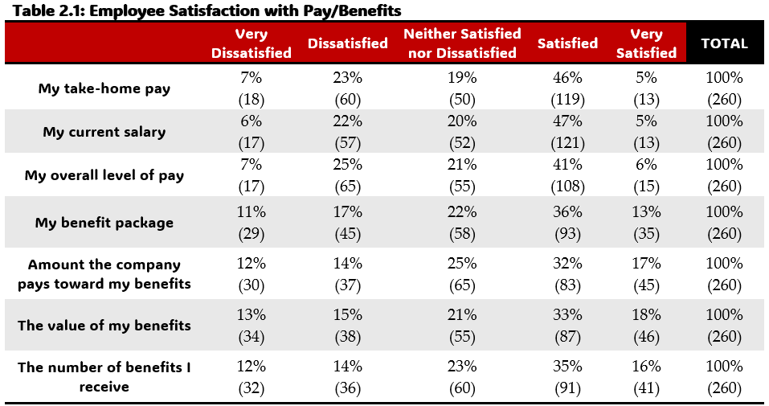
PART 2: Satisfaction with Pay and Benefits
Notes:
1. We measured employee satisfaction of…(read categories) on a five-point Likert scale ranging from very dissatisfied to very satisfied.
1. We found that about half of nonprofit employees are content with their pay, one-fifth are neutral, and one-third are unhappy.
2. Additionally, for pay, both full and part time employees were consistent in their preferences.
3. When looking at benefits, we find that full and part time employees are more polarized. There are more very dissatisfied and satisfied individuals and that largely depends on if they are full or part time.
4. We find that 45% of part-time employees were dissatisfied with the number of benefits they receive, while 23% of full-time employees were dissatisfied with the number of benefits they receive.

Slide 19
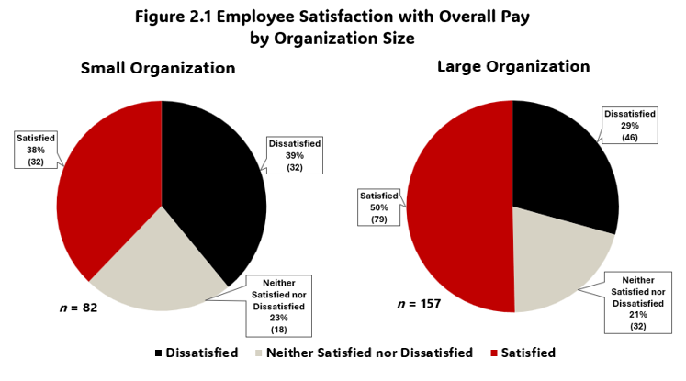
PART 2: Satisfaction with Pay
Notes:
1. Beyond full and part time employment status, when looking at organization size we find that employees in large organizations are more satisfied with their overall pay (read percentage).

Slide 20
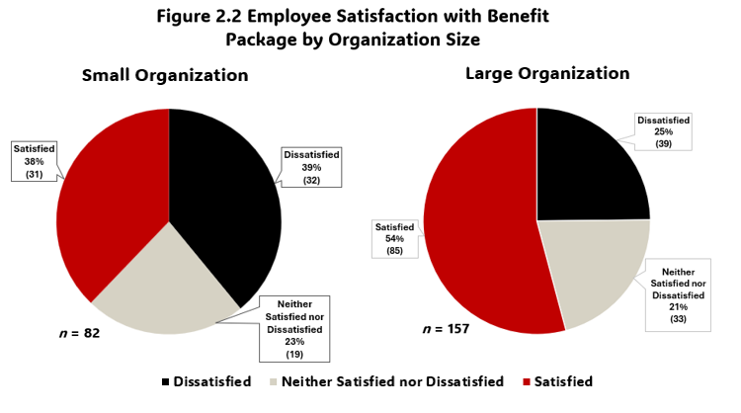
PART 2: Satisfaction with Benefits
Notes:
1. And this same trend holds for benefit packages as well with…(read percentages)

Slide 21
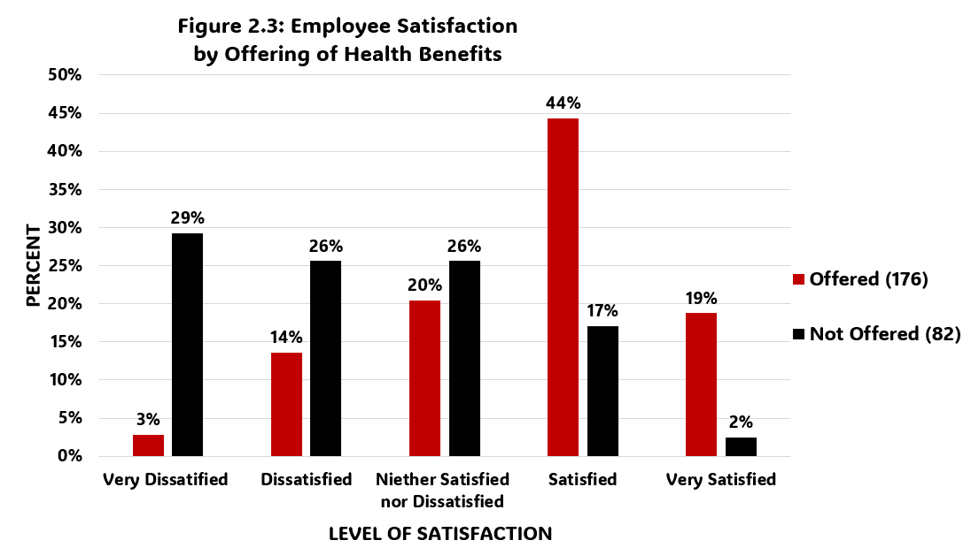
PART 2: Satisfaction with Benefits
Notes:
One final important demographical characteristic to consider when explaining employee satisfaction is whether or not their organization offers benefits.
Here we can see that there is a direct correlation with individuals being offered the benefits and their satisfaction with their benefits. (This will be important to remember when we talk about reasons for leaving here in a minute).
This was just the health benefits, but the same pattern existed with dental and vision.

Slide 22
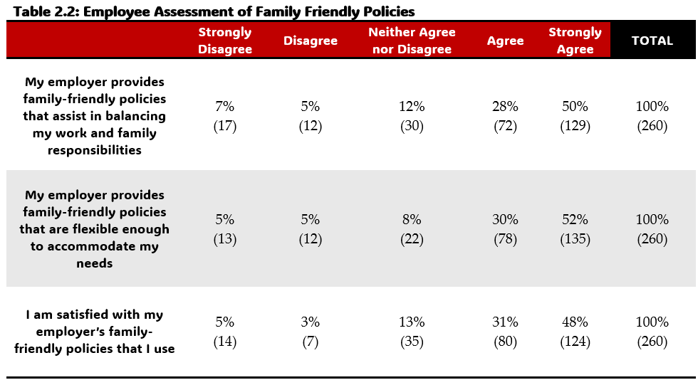
PART 2: Family-Friendly Policies
Notes:
One final area of employee satisfaction with benefits to consider is family-friendly policies.
For this study we define family-friendly simply means organizational policies that allow for flexibility and promote good work life balance.
We found that NONPROFIT ORGANIZATIONS ARE DOING REALLY WELL.
78% percent of employees felt their employer provides family-friendly policies
82% felt those policies were sufficiently flexible
79% were satisfied with the family-friendly policies.
The results were very similar across fulltime and part-time employees.
When broken down by organization, we find that 90 of the 126 organizations in this study were considered to be family-friendly places to work.
Only 16 explain the “dissatisfied” responses.

Slide 23

PART 3:
Reasons for
Leaving
Notes:
1. We will now be looking at reasons why employees may consider leaving and stick with the 260 employees level.

Slide 24
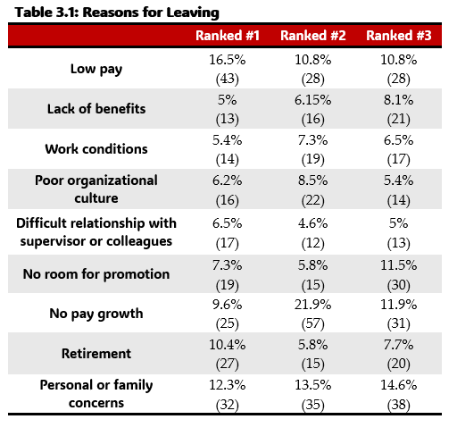
PART 3: Reasons for Leaving
Notes:
Here we asked them to rank…(read the items) by pick their top three reasons they would leave.
We found that the number one reason why an employee would leave was because of “low pay” with (read percentage) of employees ranking it as their number one reason for leaving.
The second most popular top reason was personal or family concerns (12.3%).
However, though not the highest number one reason, the reason that was most consistently included in the top three reasons for leaving was “no pay growth,” with (43.5%) including it.

Slide 25
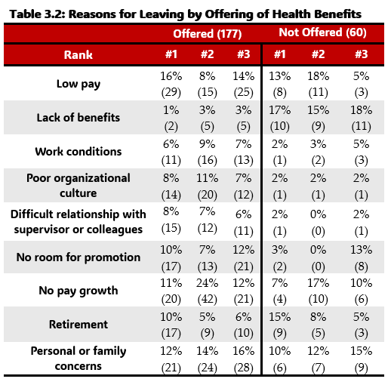
PART 3: Top Reason for Leaving
Notes:
In looking at this a little further we found that whether an organization offered benefits greatly impacted how an employee felt about benefits.
People not offered benefits are much more likely to report it as their top reason for leaving.
The previous answers of low pay and personal and family concerns remain consistent.
Thus, one simple way to increase retention would be to provide benefits, but we understand that simple may not be feasible.

Slide 26
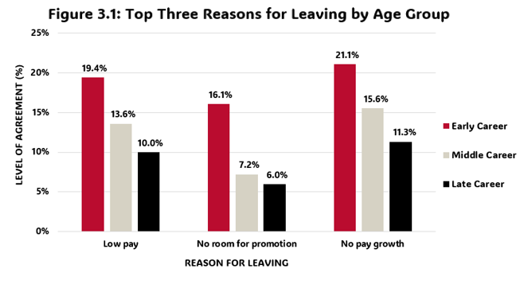
PART 3: Top Three Reasons for Leaving
Notes:
Beyond breaking reasons for leaving down by organizations offering benefits we also looked at age groups.
We defined Early career” from ages 18 - 34, “Middle career” from ages 35 – 54, and “Late career" from ages 55 and over.
Early career employees are more likely to indicate low pay (19.4%), lack of promotion opportunities (16.1%), and no pay growth (21.1%) as important reasons for leaving.
This is expected given that the older employees may be at the top of their position and pay scales while the younger employees are at the bottom.
However, despite late careered individuals not including pay in their top three reasons, when we look at their number one reason…(next slide)

Slide 27
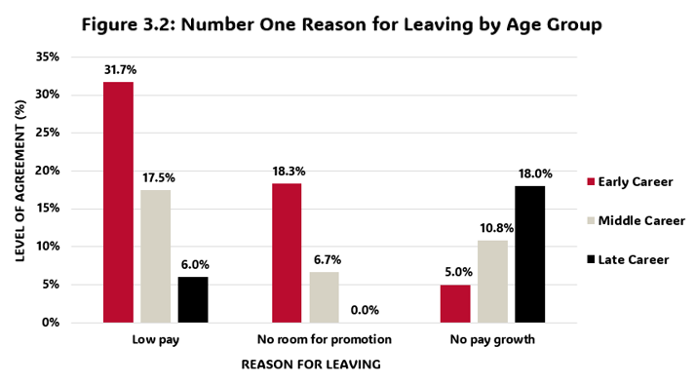
PART 3: Top Reason for Leaving
Notes:
We find that no pay growth was their highest number one reason for leaving.
For both middle career and late career, personal and family concerns were also major reasons for leaving.
As such, keeping this trends in mind, it could. be helpful for resource limited organizations to be more prescriptive to their employees needs based on how long they have been working.
Younger employees worry about pay and promotion more than older employees and so increasing opportunities to move up, creating career plans and goals, and providing professional development opportunities could all be great ways to help younger employees feel they have a future at their organization.
Middle and older employees worry about personal and family concerns and so more flexible schedules could prove useful for retaining them.
*Middle Career (16%) cited low pay, and (14%) cited personal and family concerns as their number one reasons for leaving.

Slide 28
PART 3: In One Year From Now…
85%
31%
24%
30%
Current Organization
Another Nonprofit
Government
For-profit Organization
Notes:
In addition to reasons for leaving, we asked employees the likelihood that they would be at given organizations in a year.
We found that…(read percentages)
Fourteen percent of respondents felt they were likely/very likely to retire within a year.

Slide 29



PART 4:
Job Satisfaction and Burnout
Notes:
For our final section, we know what to look at overall job satisfaction and burnout.
Previously we looked at how satisfied employees were with their benefits, but now we want to see how satisfied they are with their jobs.

Slide 30
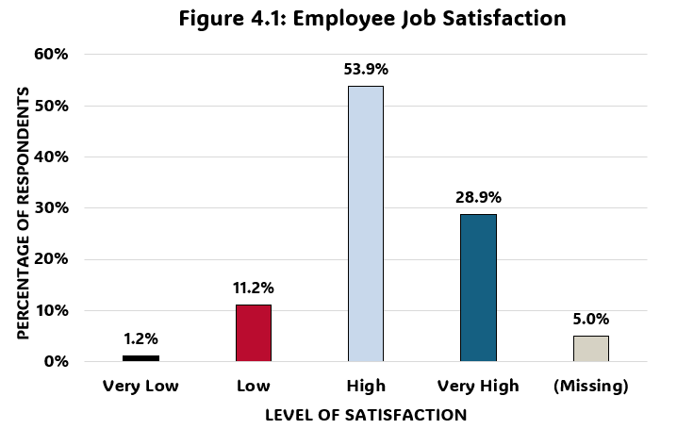
PART 4: Job Satisfaction
Notes:
We found great results in that 82.8% of the employee’s report being satisfied at their job (high or very high satisfaction).
Of those that reported low job satisfaction, 66% of them also reported it being unlikely that they would continuing working at their current organization.
Interestingly enough, this means that even among those with low job satisfaction, one third of them plan to remain at their current position.
Moreover, those that reported low job satisfaction, mainly cited poor organizational culture and difficult relationships with supervisors in their top three reasons for why they would leave their current job.

Slide 31
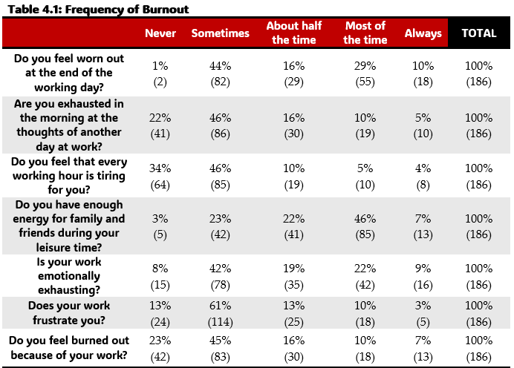
PART 4: Burnout
Notes:
On the other side of the spectrum is burnout.
We found that…(read percentages)
55% feel worn out at the end of the working day at least half of the time.
50% feel that work is emotionally exhausting half the time.
48% do not have enough energy for family and friends half the time.
One third feel burnt out and exhausted at the thought of another day at work half the time.
These are not the same people for each group.

Slide 32
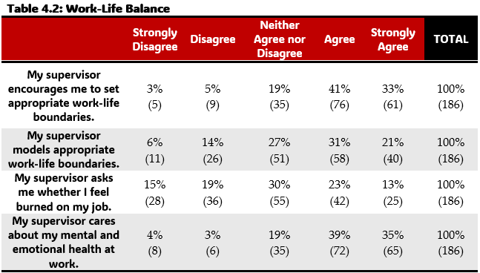
PART 4: Work Life Balance
Notes:
Finally, in connection to burnout we looked at work-life balance.
We found that nonprofits were doing good…
Around 75% of employees report that their supervisors care about their mental and emotional health and encourage them to set appropriate work-life boundaries
The only room for improvement was for supervisors to reach out more and ask their employees if they are feeling burnout out (34%).

Slide 33
Summary
Over half of Georgia nonprofits offer benefits, but there are disparities between large and small nonprofits.
Georgia nonprofits are doing good at providing family-friendly policies and professional development.
Working at an organization that offers benefits increases satisfaction with benefits.
The most important reasons for leaving an organization are low pay, no pay growth, lack of benefits, and personal or family concerns.
Georgia nonprofit employees have high job satisfaction.
More than one-third of employees reported symptoms of burnout at work.
Notes:
1. We have covered a lot of information, but some key takeaways are…(read points)

Slide 34
What does all this mean?
What do you think Georgia nonprofits are doing well? What can they improve on?
Do these results resonate with you? Why or why not?
Does offering flexible work schedules mitigate the drawbacks of not offering benefits?
Based on what you have learned, what ideas do you have to for nonprofit employee retention?
Notes:
Now we want to hear from you…
We had a few questions we wanted to ask…
We would love to take any questions though outside of these if you have them

Slide 35
THANK YOU

