Slide 1
American Government Power and Purpose
Lowi, Ginsberg, Shepsle, Ansolabehere
The Media
Chapter 14

Slide 2
The Media as a Political Institution
Although not a formal branch of the U.S. government, the media play a critical institutional role in the political system
It is impossible to maintain a democratic political system over time without a properly functioning media
Notes:
Discussion:
Ask students to explain why a properly functioning media is essential in a democratic political system. Alternatively, explain that democratic political systems are heavily reliant on informed public participation. Without a properly functioning media, citizens would lack sufficient information to inform their participation in politics. The relationship between Donald Trump and the press corps that covers the president has gotten off to a very difficult start, and the relationship has observers reconsidering how the media will be able to inform the American public in the coming years.

Slide 3
The Media as a Political Institution: Diversity
A diversity of sources, firms, and technologies makes up the media
Daily newspapers
Television stations and networks
Weekly magazines
Countless websites
Available in most every language

Slide 4
Clicker Question 1
From which type of media outlet do you receive the majority of your news?
newspapers/print media
television/radio
Internet
none
Notes:
Discussion:
This clicker question can be used to start a discussion about the media sources students utilize most and get them to think about how other demographic groups might respond differently.

Slide 5
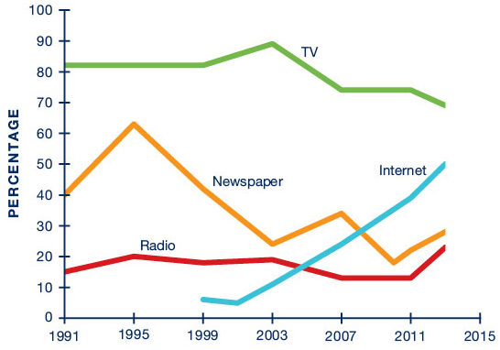
Clicker Question 1 (Figure)
From which type of media outlet do you receive the majority of your news?
Notes:
Discussion:
The Internet is rapidly becoming the main source for news for Americans, and this change has some very important impacts on what Americans know.

Slide 6
Broadcast Media
Television
Networks: CBS, NBC, ABC (1950s)
Cable news: CNN (1980s), Fox News (1990s), and MSNBC (2000s)
Broadcast media engage in very little actual reporting
Radio
Talk radio is a powerful medium for mobilizing American conservatives
Left-wing radio has been less successful
Notes:
Discussion:
Television news coverage began in earnest in the 1950s with CBS, NBC, and ABC, which were made available over television airwaves. With the advent of cable television, CNN (in the 1980s) and Fox News ( in the 1990s) became major broadcast news players.
Ask students to identify political talk radio personalities. Why has right-wing talk radio been politically more successful than its left-wing counterpart?

Slide 7
Broadcast Media and the History Principle
With the advent of radio broadcasts in the 1920s, the need for regulation became evident, as broadcasters would vary their signal strength and the frequency they would use
Government had to regulate, and that impacts the media environment today
This is the history principle at work

Slide 8
Types of Media: Print
Newspapers and magazines are the oldest forms of printed political communication
Print journalism allows for greater context, depth, and analysis than other formats do
Competition from other news formats—especially the Internet—threatens the viability of print media
Notes:
Discussion:
Ask students to name the nation’s most influential newspapers and magazines. Note that the New York Times, Washington Post, and Los Angeles Times are located in major American cities: New York, the financial capital; Washington, the political capital; and Los Angeles, the entertainment capital. Ask students to name influential newsmagazines (Time, U.S. News & World Report, Newsweek). Highlight financial difficulties facing print media due to the costs of printing and distributing materials.
The threat to the viability of print journalism is particularly troubling at the local level. If small-town newspapers cease to exist, awareness of and participation in local affairs is likely to decline.

Slide 9
The Internet
The Internet has emerged as a powerful new technology for the dissemination of news and information, with a wide variety of political perspectives
Many Internet news sites aggregate news collected by other media
Politicians increasingly communicate with voters through social network sites such as Facebook and Twitter
Notes:
Discussion:
The Internet is at least as important as previous revolutions in human communication, including the printing press, the telegraph, and radio and television. Each of these new technologies radically changed the way news could be covered and the impact each medium had on the political discourse. The full implications of the Internet’s impact on news and politics are far from clear. But one key difference is the ways it allows people to get involved through commentary, debate, and even the ability for citizen journalists to upload content like pictures and video. Donald Trump’s use of Twitter and social media during the 2016 presidential campaign arguably led to his victory. John Oliver poked fun at the difference between the Trump campaign and the Clinton campaign’s use of social media: https://www.youtube.com/watch?v=HLkht1bCvzw.
News aggregation sites essentially profit from the work of others. Because news can so easily be aggregated on the Internet, it raises questions about whether a profit can ultimately be derived from newsgathering.
Ask students to name Internet-only news websites that they are familiar with. Do they note any discernible partisan slant?

Slide 10
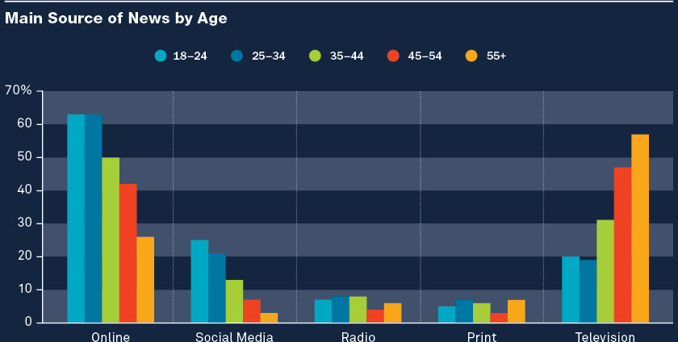
News Sources: A Generational Gap
Young people get much more of their news from online and social media sources
Older people get more news from television
Notes:
Discussion:
Ask students to identify major trends shown in the table, including less overall consumption of news in print and radio.
What are the implications of greater reliance on Internet-based news in light of the absence of traditional journalistic standards?

Slide 11
Regulation of the Electronic and Broadcast News Media
In the United States, the government neither owns nor controls broadcast networks
The government does regulate content and ownership of broadcast media, but print media are free from government interference
This tendency can be traced to First Amendment protections for the press

Slide 12
Regulation of News Media
Broadcast media face greater scrutiny from federal regulators than do other media
Content and ownership are key issues
The FCC licenses broadcasters and regulates profanity, obscenity, and indecency
Notes:
Discussion:
Ask students what the rise of the Internet, with its relatively more regulation-free environment, means for regulation of the news media.

Slide 13
Regulation of Broadcast Media: FCC Regulations
Equal time rule—broadcasters must provide candidates for the same office an equal opportunity to communicate their messages
Right of rebuttal—individuals have the right to respond to personal attacks
Fairness doctrine—the FCC requires broadcasters to provide time for opposing views on issues
Notes:
Discussion:
The important point is that each of these regulations has been relaxed in recent years.

Slide 14
The Internet and Government Regulation
Federal regulation of the Internet is also highly contested
Supporters argue that content originators should be protected from websites that facilitate the distribution of protected content
Foreign-based Internet companies can easily escape federal regulation

Slide 15
Clicker Question 2
Which of the following is NOT an example of government attempts to ensure a diversity of opinion in news coverage?
A. equal time rule
B. right of rebuttal
C. 1996 Telecommunications Act
D. fairness doctrine
Notes:
Answer: C. 1996 Telecommunications Act

Slide 16
Clicker Question 2 (Answer)
Which of the following is NOT an example of government attempts to ensure a diversity of opinion in news coverage?
A. equal time rule
B. right of rebuttal
C. 1996 Telecommunications Act
D. fairness doctrine
Notes:
Answer: C. 1996 Telecommunications Act
By loosening restrictions on ownership of media, the 1996 Telecommunications Act has actually reduced the diversity of viewpoints expressed in broadcast media.

Slide 17
Freedom of the Press
Guaranteed in the First Amendment
Prior restraint—an effort by a government agency to block the publication of material it deems libelous or harmful in some other way
Near v. Minnesota (1931) set a high legal threshold for government prior restraint
Notes:
Discussion:
Although prior restraint is rare, newspapers can still be held accountable after publication if material is found to be libelous—that is, published with “reckless disregard for the truth” or “actual malice.” There is a terrific book called Minnesota Rag about the story behind Near v. Minnesota that can be used as a supplemental reading.

Slide 18
Organization and Ownership of the Media
Today, there are
More than 2,000 television stations
Approximately 1,400 daily newspapers
More than 13,000 radio stations
20 major television networks
By 2014, Fox News was the second highest rated weekday primetime cable channel, trailing only ESPN; Fox has 2.3 million viewers per night in primetime

Slide 19
Organization and Ownership of the Media
1996 Telecommunications Act led to media consolidation
The Internet can provide a counterweight to media consolidation
But there are surprisingly few distinct national sources for news
Notes:
Discussion:
The issue of consolidation raises questions about whether a small number of large conglomerates can provide the diversity of opinion necessary for an informed citizenry. Many argue that, overall, the Internet promotes greater diversity of opinion than existed previously, mitigating many of the threats posed by corporate homogenization of the news.

Slide 20
Few Corporations Control the Majority of U.S. Media
Notes:
Discussion:
Ask students to consider the implications of media consolidation, including possible advantages and disadvantages. Does the fact that fewer than 10 large corporations control the majority of the media outlets constitute a threat to democracy itself? Can the Internet provide a legitimate counterweight to corporate media?

Slide 21
What Affects News Coverage?: Journalists
Journalists play a critical role in shaping news coverage
Although most journalists strive for objectivity, personal biases inevitably shape their perspectives
What do journalists want?
Ratings
Career success
Professional prestige
Notes:
Discussion:
Because the quality of news is so critical in a democracy, it is important to know the factors that can have an impact on the way news is produced. During the 1920s, objective journalism emerged to minimize personal biases in news coverage. New schools of journalism began to teach generations of journalists objective reporting, emphasizing facts (who, what, when, where) over sensationalism and opinion. The objective style of journalism emerged as a backlash to the previous era known for “yellow journalism,” a highly sensationalistic style of reporting that emphasized, above all, selling news as a product.
In examining the current state of American journalism, have we returned to a yellow, partisan press characteristic of the nineteenth-century American media?

Slide 22
Journalists
In recent years, there has been greater acceptance of partisanship among journalists
Media moguls William Randolph Hearst (1863–1951), Rupert Murdoch (born 1931), and others have shaped news coverage through their biases and business interests
Notes:
Discussion:
The emergence of Fox News during the 1990s is seen as a driving force behind increasingly partisan coverage of the news. Fox’s often right-leaning coverage of the news has produced high ratings, prompting other news outlets, such as MSNBC, to attempt to emulate the partisan format. Since Fox’s emergence, CNN has struggled, alternating between trying to remain nonpartisan and trying to offer bipartisan analysis by inviting representatives from both sides to every discussion.

Slide 23
Do Journalists Bias the News?
More journalists identify themselves as Democrats and liberals than as Republicans and conservatives
Most studies have failed to identify major biases in coverage of national politics, though some subtle biases do exist
Notes:
Discussion:
Groseclose and Milyo (2005) found that most reporters do tend to use more loaded terminology when referring to conservatives as opposed to liberals. But the effect is reversed when more conservative outlets like the Wall Street Journal or Fox News are examined.
In the 2016 primary campaign, Donald Trump received considerably more coverage than his opponents, and this played a significant role in his ability to secure the Republican nomination without spending as much as his opponents.

Slide 24
Newspaper Endorsements
Notes:
Discussion:
Figure 14.3 documents partisan trends in newspaper endorsements since 1932. Interestingly, a significant majority of American newspapers supported Republican candidates up until the 1990s, when newspaper endorsements shifted dramatically in favor of Democratic candidates. In the 2016 campaign, the partisan gap in endorsements was as large as it had ever been and, while the endorsements almost universally favored Hillary Clinton, they seemed to make no difference to the voters.

Slide 25
Citizen Journalism
The emergence of citizen journalism, enabled by the Internet, promotes a wider variety of perspectives
Citizen journalists played a major role in recent crises in Egypt, Libya, and Syria
Critics of citizen journalism express concern about upholding traditional journalistic standards and training

Slide 26
News Sources: News Leaks
Individuals shape news through the dissemination of confidential information
In 1971, Daniel Ellsberg, a military analyst employed by the RAND Corporation, released to the New York Times the Pentagon Papers, a top-secret study of U.S. involvement in the Vietnam War
Edward Snowden, who leaked information about NSA wiretapping, is a more contemporary but no less controversial figure
Notes:
Discussion:
The documentary The Most Dangerous Man in America (2010) examines the impact of the release of the Pentagon papers on American politics and on Daniel Ellsberg’s career. In 2016, of course, a full-length movie was released on Edward Snowden’s story.
In the 2016 presidential campaign, Wikileaks released a steady stream of emails from DNC or Clinton campaign sources.

Slide 27
News Sources: Press Releases
A press release is a story written by an advocate or publicist and distributed to the media in the hope that journalists will publish it under their own byline
Today, there are “video news releases” that are designed to look like news stories created by independent journalists

Slide 28
Clicker Question 3
What level of confidence do you have that the news media cover events in ways that inform political debate in our democracy?
highly confident
somewhat confident
somewhat dubious
highly dubious
Notes:
Answer: No right answer.
This question may be used to launch a discussion in class.

Slide 29
Consumers
The news business is ultimately geared toward making a profit
By attracting lucrative advertising, news outlets cater to an upscale audience
“If it bleeds, it leads”—news is tailored to consumer preferences for entertainment
Notes:
Discussion:
Although there is a tendency to blame media outlets for favoring sensationalistic coverage of the news, a rational-choice explanation would suggest that media outlets that portray sensationalism and news as entertainment are simply responding to consumer preferences. By promoting sensational and entertaining news stories, is the media creating or merely responding to consumer desires?

Slide 30
Education Level and Attention to the News
Notes:
Discussion:
Highlight the correlation between education and attention to hard news, pointing out the distinction between hard and soft news. Why do increasing levels of education lead to greater interest in news? Does a more highly educated population necessarily lead to a better-informed public and, ultimately, public policy outcomes that reflect democratic preferences?

Slide 31
The Media and Conflict
The media are sometimes accused of encouraging conflict and even violence because viewers tune in for dramatic stories
But protest as a strategy for attracting media coverage does not always work, as the media frequently focus on the conflict rather than the issues at stake

Slide 32
Media Power and Responsibility
The media play a powerful role in shaping public perception of news events
Civil rights movement
War in Iraq
2016 presidential election
There is inherent tension between a free press and a responsible press

Slide 33
Clicker Question 4
Is the media a democratic political institution?
Yes. Because consumers drive media coverage, the media is a reflection of popular will.
No. Journalistic biases and elite control of the media make the media less than democratic.
Notes:
Answer: No right answer.
This question may be used to launch a discussion in class, or it may be used as a writing assignment.

Slide 34
Additional Information
Following this slide, you will find additional images, figures, and tables from the textbook.

Slide 35
Who Runs the Internet?

Slide 36
Analyzing the Evidence: Where Do Americans Get Political News?
Notes:
Most of political life is distant from our own personal experience and social circles. Thus when we know something about a recent international summit, a deal made in Congress, or a war abroad, it is usually because someone covered it as news.
How people get news, however, is changing and varies across generations. Throughout the twentieth century, news media were Americans’ number one source of information about politics. Traditionally, newspapers have produced the most detailed and extensive coverage, and television has reached the widest audiences and was for several decades the most important source of news for many.
The development and spread of digital media from the 1990s onward has changed the news media landscape. Newspapers have seen declining readership, make less money, and therefore invest less in news production. Television audiences have been more stable but are increasingly made up of older people. Younger people increasingly get news online.
By 2015, 85 percent of all Americans used the Internet, and 64 percent had a smartphone.1 Among people who are online, digital media have now overtaken television as the most important sources of news. In 2015, 43 percent of American Internet users named digital sources as their most important sources of news, compared to 40 percent who named television and 5 percent who named printed newspapers.
There are clear generational differences in how people get news. Older Americans rely far more on traditional media, such as television, than do younger people, who mostly get news online. For some people, getting news online is about going directly to the websites and apps of news organizations, whether newspapers like the New York Times, broadcasters like NBC, or digital-only news sites like the Huffington Post. But for many, online news is increasingly accessed via digital intermediaries like search engines, messaging apps, and social media. In 2015, 11 percent of American Internet users named social media their main sources of news.
The graph above shows that some social media, such as Twitter, are often directly linked with news. In contrast, people mostly visit Facebook for other reasons but often stumble upon news when on the site. A changing media environment has sometimes been associated with the rise of “selective exposure,” where people seek out information that reflects their existing views. However, the rise of widely used social media like Facebook seems to be associated with a resurgence in “incidental exposure,” where people come across news unintentionally.

