Slide 1
American Government
Power and Purpose
Lowi, Ginsberg, Shepsle, Ansolabehere
Groups and Interests
Chapter 13

Slide 2
The Pull and Push of Groups and Interests
There is a “pull” and a “push” organizing political activity in the United States
  There is a pull from government to gather information on how governmental decisions will affect various constituencies
  There is a push from individuals and groups seeking to gain some benefit
This is pluralism at work
Notes:
Discussion:
The “pull” is the part of this that is probably less familiar to most students. Most students already know that groups seek to “push” government for benefits and policies they prefer. But the role of interest groups in providing information to government is something students may not have thought about or may not see as a potentially positive role for interest groups in the political system.

Slide 3
Groups and Pluralism 1
An interest group is an organized group of individuals or organizations that makes policy-related appeals to government
  Interest groups enhance democracy by representing individuals, encouraging political participation, and educating the public
  But interest groups represent the private interests of a few, not the public interest
Madison’s answer to this was diversity
Notes:
Discussion:
In Federalist 10, James Madison argued that there is a dilemma inherent in interest group activity. On the one hand, allowing individuals to form groups to press their demands on government is the essence of freedom, and limiting that freedom would be tyranny. In Madison’s words, this cure would be “worse than the disease.” The answer, for Madison at least, is to have a multitude of factions. The greater the diversity of interests competing for their own private benefit, the less likely it is that any one of them will dominate the system. In other words, these interests will regulate one another, and the result will be compromise and moderation.

Slide 4
Groups and Pluralism 2
Pluralism is a condition or system in which many groups, interests, or ideas co-exist in a nation and share political power
  As long as all groups are free to organize, the system is arguably democratic, as individuals will join groups they support and will not join groups they oppose
  Bigger groups will have power, as they should
But some groups organize more easily
Notes:
Discussion:
It is important to note the critiques of pluralism (for example, it over-represents the wealthy and the well-educated). The next few slides outline the characteristics of groups and make the point that some interests organize more easily than others do. But it is useful to ask students to think through the logic of pluralism on their own first by asking them to what extent they think pluralism can be characterized as democratic. Do all individuals have an equal opportunity to influence the pluralist system?

Slide 5
Organized Interests Are Predominantly Economic
Economic interest is one of the main purposes for which individuals form groups
Examples of groups that protect economic interests:
  American Farm Bureau Federation
  AFL-CIO
  American Medical Association
Notes:
Discussion:
Groups that are formed to protect economic interests find it easier to organize because members readily see the benefits of organization (economic) weighed against the costs. Individuals organizing to pursue a social policy agenda may have a more difficult time weighing the costs (financial and other) against the benefits, as the costs and benefits are in different units.

Slide 6
What Do Groups Need?
Members, Money, Leadership
Groups with more members are more powerful
AARP is powerful because it represents so many active voters
Groups need money to sustain the organization and to fund their activities (lobbying, voter education, etc.)
Groups with access and organizational discipline are more successful

Slide 7
Group Membership Has an Upper-Class Bias
People with higher incomes and higher levels of education are more likely to be members of interest groups
There is thus an upper-class bias in the interest-group system
The bottom rungs of the socioeconomic ladder are represented by some groups, but political parties do a better job of representing these interests
Notes:
Discussion:
E. E. Schattschneider made this argument best in his classic work The Semi-Sovereign People. Schattschneider concluded, “The flaw in the pluralist heaven is that the heavenly chorus sings with a strong upper-class accent.”

Slide 8
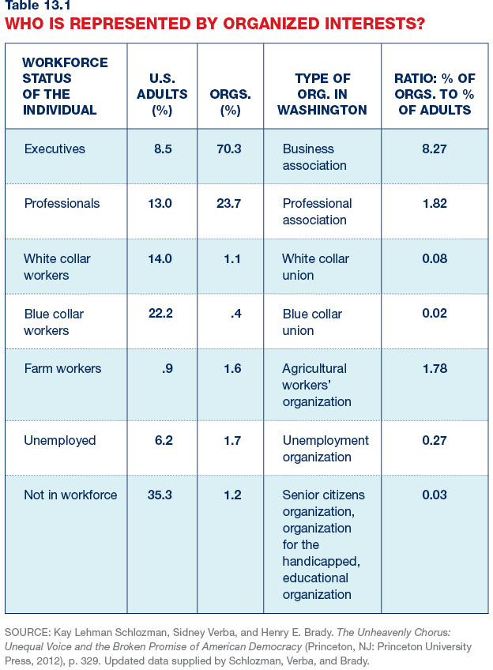
How and Why Do Interest Groups Form?
Notes:
Discussion:
Pluralist theory suggests that interest groups form whenever there is a group interest to be organized. But this does not always happen. Indeed, some types of interests seem to form more easily than others do. The data in Table 13.1 show that executives and professionals seem to organize more easily than other interests do. Some groups, such as college students, are “latent groups” because they may have common interests but do not necessarily form into an interest group.

Slide 9
Group Activity Reflects the Political Environment
Periods of significant change or social and economic upheaval usually signal a burst of group activity
  Group activity grew during the 1880s and 1890s as government became more active in seeking to regulate interstate commerce
  The federal government’s growth in the 1930s led to another burst of group activity
There are thousands of groups at the national, state, and local level
Notes:
Discussion:
More recently, interest group activity grew with the civil rights and anti-war movements of the 1960s and in the last decade with the rise of the anti-tax Tea Party movement and Black Lives Matter protesting racial discrimination.

Slide 10
Interest Groups Facilitate Cooperation
Collections of individuals might have common goals and might benefit from cooperation, but cooperation is not easy
Individuals may not see their common goals or may lack individual incentives to work together

Slide 11
Problems of Organization:
The Prisoner’s Dilemma
You and a friend have committed a crime
The police have arrested both of you and have placed you in separate rooms
The police think they have enough evidence to convict you both of a lesser crime
But they want you to snitch on your friend
Of course, they have offered your friend the same deal

Slide 12
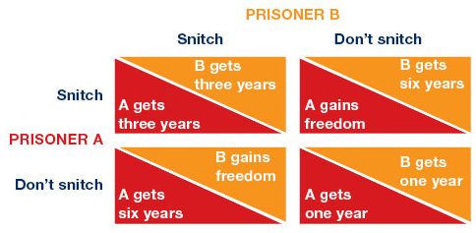
The Solution to the
Prisoner’s Dilemma
Notes:
Discussion:
This figure can be difficult to read, so it is worth explaining this to students. Look at the prisoner’s dilemma from the perspective of Prisoner A. Prisoner A is faced with a binary decision, and the possible outcomes for Prisoner A are listed in the darker triangles. If Prisoner A snitches, his outcomes are three years or zero years. If Prisoner A does not snitch, his outcomes are six years and one year. Obviously, Prisoner A is better off snitching no matter what Prisoner B does. The same is true for Prisoner B. So, it is individually rational for BOTH Prisoner A and Prisoner B to snitch. But what is the collectively rational thing to do? If we add up the total years in prison (spent by Prisoner A and B) in all four quadrants, we find that the smallest collective number of years in prison is in the lower right quadrant. This only happens if both Prisoners A and B don’t snitch. So, the best collective outcome requires that both Prisoners behave in a way that is not individually rational. This is why the prisoner’s dilemma is a dilemma.

Slide 13
The Logic of Collective Action
In The Logic of Collective Action, Mancur Olson argues that individuals organizing into groups face the prisoner’s dilemma
  They are tempted to let others pay the costs
  No individual is incentivized to work for the collective good
  This difficulty is most severe in large groups
Thus, groups of individuals who share an interest often do not organize to pursue it
Notes:
Discussion:
The difficulty is most severe in large groups because (1) individuals are most anonymous in large groups, so nobody will know if an individual chooses not to contribute; (2) it is easy for individuals in a large group to believe that their individual contributions will not make a difference; and (3) there is nobody to enforce cooperation and hold individuals accountable.

Slide 14
Collective Action:
Selective Benefits as a Solution
Selective benefits are those that go only to those who contribute to the group
Benefits can be
  Informational
  Material
  Solidary
  Purposive
This is an example of the institution principle in action
Notes:
Discussion:
Group leaders create selective benefits and institutions to give these benefits only to members to overcome the difficulties of collective action.

Slide 15
Types of Selective Benefits
Informational: newsletters, periodicals, training programs, conferences, and other information
Material: goods and services
Solidary: friendship, networking
Purposive: accomplishments

Slide 16
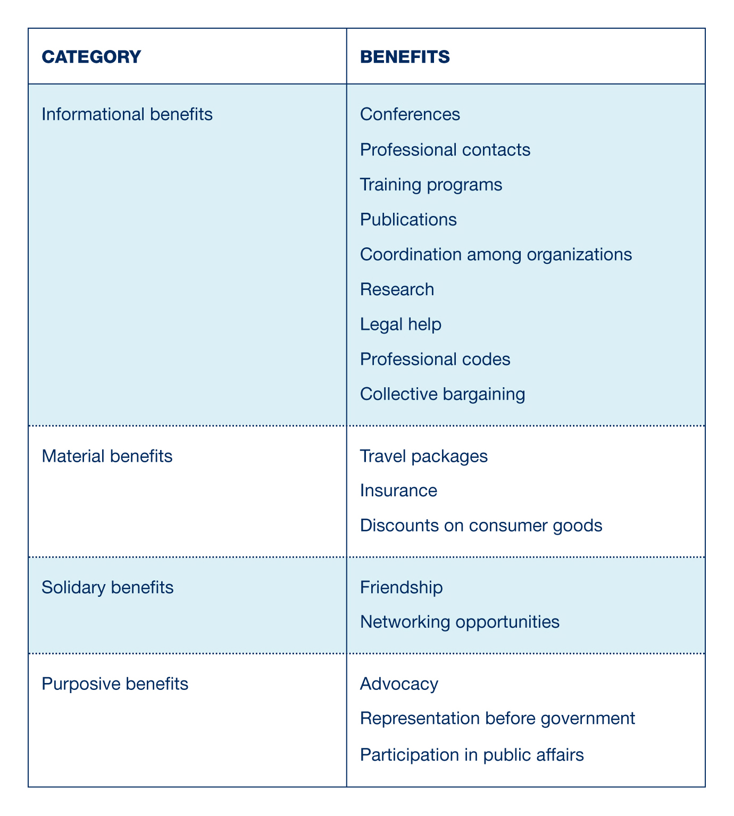
Selective Benefits

Slide 17
Political Entrepreneurs and Groups
Selective benefits will not organize a group if there is no leadership to do the work
We call these leaders “political entrepreneurs,” and they accrue benefits in return for doing the work of organizing
These entrepreneurs are a complement to selective benefits in overcoming collective action problems

Slide 18
How Do Interest Groups Influence Policy?
Insider strategies
  Directly influencing decision makers
  Pursuing advocacy through the courts
Outsider strategies
  Educating the public
  Campaigning and contributing to candidates
Many groups employ a mix of insider and outsider strategies

Slide 19
Interest Group Influence:
Direct Lobbying 1
Lobbying is an attempt by a group to influence the policy process through persuasion of government officials
Billions of dollars are spent on lobbying each year
Lobbying is thought of negatively, but lobbyists do make positive contributions:
  Provide information
  Make sure group concerns are heard

Slide 20
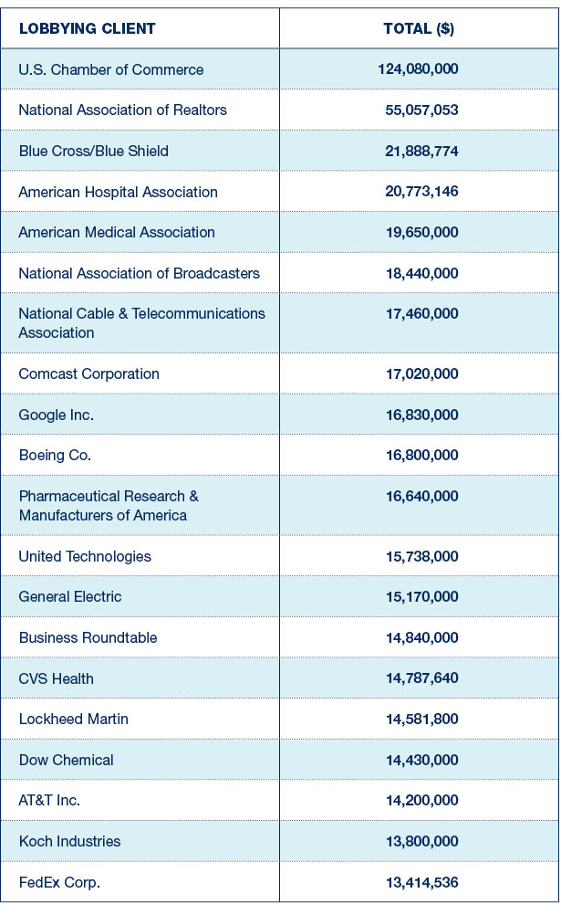
Top Spenders on Lobbying in 2014
Notes:
Discussion:
This list of the top spenders on lobbying also emphasizes the point made earlier that the interest-group system represents the interests of corporations and wealthy individuals quite well but does not represent the interests of the poor very well.

Slide 21
Interest Group Influence:
Direct Lobbying 2
Lobbyists also seek to influence other parts of government by
  Lobbying the president
  Lobbying the executive branch
There are some regulations on lobbying:
  Groups must report spending on lobbying
  There are strict limits on gifts from lobbyists
  Lobbyists must register with the Secretary of the Senate and the Clerk of the House of Representatives
Notes:
Discussion:
Students (and the public) generally have a negative view of interest groups and see them as being corrupt. On the first day of the new Congress in 2017, Republicans found themselves in political hot water after they tried to weaken the House Ethics investigation process.

Slide 22
Interest Group Influence:
Using the Courts
Interest groups seek to influence policy through the courts by
  Bringing suits directly on behalf of their group
  Financing suits brought by others
  Filing amicus curiae briefs
Brown v. Board of Education (1954) is an example of a case brought by groups (notably the NAACP) to advance a policy agenda

Slide 23
Interest Group Influence:
Mobilizing Public Opinion
Interest groups try to pressure politicians by mobilizing public opinion
One way to do this is to “go public”—the act of launching a media campaign to build popular support
This includes advertising campaigns, protests, grassroots lobbying efforts, and building lists of supporters and urging them to pressure officials
Notes:
Discussion:
One classic example of a particularly successful grassroots lobbying campaign is the famous “Harry and Louise” ads that helped block President Clinton’s health care reform effort in the mid-1990s. The actual ads can be found here: http://www.youtube.com/watch?v=Dt31nhleeCg. Interest groups also seek to influence public opinion by showing up on free media on radio, television, and the Internet to advocate for their cause. Stephen Colbert had an ongoing series called “Better Know a Lobby”; in one humorous example, he interviewed Carl Pope, the head of the Sierra Club: http://www.cc.com/video-clips/ytt7lh/the-colbert-report-better-know-a-lobby---sierra-club.

Slide 24
Interest Group Influence:
Using Electoral Politics
Political action committees
  PACs are private groups that raise and distribute funds for use in election campaigns
  PACs give to candidates and to parties
  In 2014, PACs contributed over $470 million
Independent expenditures
  Groups spend money on voter education
  As long as it is not coordinated with a campaign, spending in this category may be unlimited

Slide 25
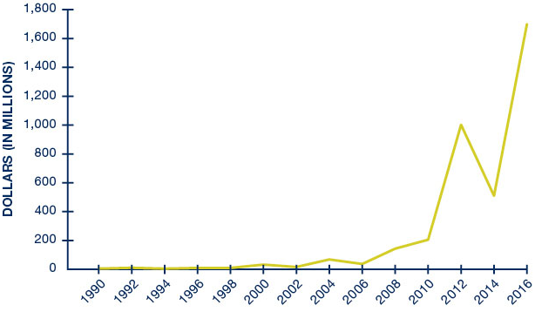
Independent Expenditures per Election Cycle
Notes:
Discussion:
Independent expenditures exploded in the last six years and now amount to nearly $2 billion.

Slide 26
Are Interest Groups Effective?
The evidence is surprisingly mixed
  Some research has found that advocacy rarely yields returns
  Other research has found that the small amount of money corporations spend on advocacy is a sign that it is not worth much to them
However, if advocacy did not work, groups would not spend money on it at all
Notes:
Discussion:
At the end of this chapter on groups and interests, the authors employ an interesting thought experiment in asking whether groups are effective. They ask why, if spending on politics is so lucrative for corporations, they don’t spend more? Relative to other investments (like hiring employees, purchasing equipment, etc.), corporations spend very little on politics. One reason may be that groups are seeking to free ride on the investments of others. Regardless of the reason, it is useful to ask students why groups spend less on politics than on some of these other investments and, more broadly, whether they think interest groups are as effective as they could be in the American political system.

Slide 27
Additional Information
Following this slide, you will find additional images, figures, and tables from the textbook.

Slide 28

The Mortgage Interest Tax Deduction
Notes:
A home for sale in Durham, North Carolina.

Slide 29
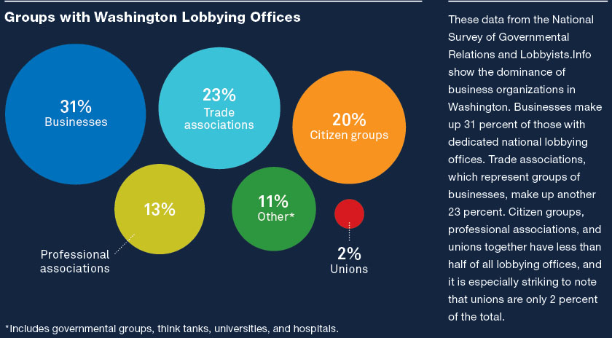
Analyzing the Evidence: Interest Group Influence 1
Notes:
Which interest groups have the most influence over political outcomes? It is generally accepted among those who study interest groups that business and economic interests predominate. Economic interests are more likely to form organized groups, are more likely to be active, and on average spend more money and more time on political issues than are noneconomic interests like citizen groups or “public interest” groups. When we look at interest groups’ involvement in the policy-making process, however, the sheer number of groups or dollars may not directly equal the amount of influence that those groups have. While numbers and dollars are important indicators of which interests are represented, it would be preferable to try to measure which groups actually were influential in politics. To address this question, the political scientist Frank Baumgartner and his colleagues interviewed 315 lobbyists and government officials about 98 randomly selected policy issues. Citizen groups were more likely to be mentioned as being important in the debates than any other type of group, despite the fact that they spent less and they made up a smaller part of the overall group population.
Why were citizen groups seen as so influential despite their relative lack of resources? It may be that those groups have important ties to constituents, granting them greater legitimacy in the eyes of members of Congress, or it could be that some members of Congress already supported the policies that the citizen groups were advocating. Whatever the reason, it is clear that citizen groups have greater voice in Washington than the dollar counts might suggest.
These data from the National Survey of Governmental Relations and Lobbyists. Info show the dominance of business organizations in Washington. Businesses make up 31 percent of those with dedicated national lobbying offices. Trade associations, which represent groups of businesses, make up another 23 percent. Citizen groups, professional associations, and unions together have less than half of all lobbying offices, and it is especially striking to note that unions are only 2 percent of the total.

Slide 30
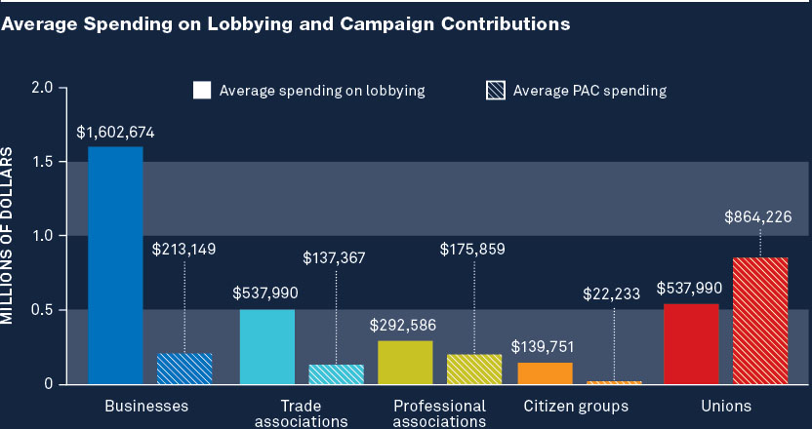
Analyzing the Evidence: Interest Group Influence 2
Notes:
The graph shows the average amounts spent on lobbying or campaign contributions by interest groups. Citizen groups on average spent much less on lobbying and campaign contributions than other types of groups. Unions on average spent more on campaign contributions than any other type of group, but that spending is tempered by the fact that there are fewer unions. (Note: Lobbying figures represent total reported spending in 2012; PAC campaign contributions are for the two-year election period ending with the 2012 election.)

Slide 31
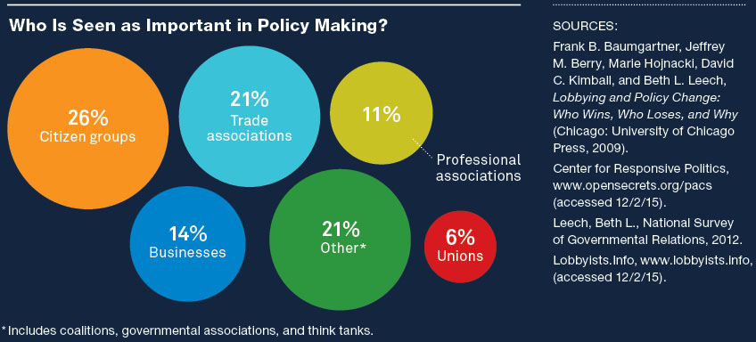
Analyzing the Evidence: Interest Group Influence 3
Notes:
Although the overall population of interest groups has fewer citizen groups than business groups, as seen in the figure on the facing page, not all groups are equally influential. Baumgartner and his colleagues interviewed 315 lobbyists and government officials about 98 randomly selected policy issues. Citizen groups were more likely to be mentioned as being important in the debate than any other type of group. More than a quarter of the interest groups seen as being influential were citizen groups.

