Slide 1
American Government Power and Purpose
Lowi, Ginsberg, Shepsle, Ansolabehere
Public Opinion
Chapter 10

Slide 2
What Is Public Opinion?
Citizens’ attitudes about political issues, leaders, institutions, and events
May be understood on two levels:
Individual: what one person thinks about issues, leaders, institutions, and events
Aggregate: the accumulation of these individual beliefs as expressed in polls, votes, town meetings, protests, and so on
Preferences, beliefs, and choices matter
Notes:
Discussion:
In the 2010 midterm congressional elections, the Democrats took a “shellacking,” according to President Obama. Despite the president’s admission, many in the media accused the president of not “getting it.” The “it” the president was accused of not getting is the public mood, a measure of public opinion.

Slide 3
Preferences, Beliefs, and Choices
Preferences are shaped by economic self-interest and social or moral values; some preferences may be held more firmly than others
Beliefs reflect how people understand the world and the consequences of actions
The choices presented to us do not always yield a clear measure of our preferences or beliefs
Notes:
Discussion:
The role of choices is quite important but is frequently ignored in public opinion. In a given election or in a survey, we might be asked to choose between two candidates or between two statements of a position on an issue. Since no candidate or statement is likely to match our preferences and beliefs perfectly, the outcome of the election or survey will not render a perfect picture of our true preferences and beliefs. Instead, they serve as an imperfect (sometimes very imperfect) proxy measure.

Slide 4
Variety of Opinion
Americans do hold common opinions on some issues, such as equality of opportunity, but do not hold a single view on most of them
What we’re interested in knowing:
Evaluations of individuals and institutions
Assessments of public policies
Assessments of current circumstances
Political orientations
Notes:
Discussion:
One way to get students to think about the variety within the scope of public opinion is to think about political culture, ideology, and public opinion as three distinct concepts. Political culture may be defined as the set of views that all (or virtually all) Americans hold in common. We agree on the legitimacy of the Constitution, we agree that democracy is a fair process for decision making, and we agree that slavery should not be allowed, among other consensus views. Note that each of these three views was not always a consensus view. Ideology is different. It is an enduring set of principles that people hold about the proper role of government in society, but people disagree in their ideological outlook. One’s ideology is likewise not the same as public opinion. Public opinion focuses on specific individuals, policies, or circumstances at a moment in time. It changes more readily (say, for example, evaluations of presidential job approval) than ideology.

Slide 5
Clicker Question 1
We can expect that public opinion will vary significantly over time on each of the following EXCEPT
the president.
environmental regulation.
equality of opportunity.
trust in government.
Notes:
Answer: C. equality of opportunity.

Slide 6
Clicker Question 1 (Answer)
We can expect that public opinion will vary significantly over time on each of the following EXCEPT
the president.
environmental regulation.
equality of opportunity.
trust in government.
Notes:
Answer: C. equality of opportunity.

Slide 7
Origins and Nature of Opinion
Individual opinions are a products of one’s personality, social characteristics, and interests
Opinions are also shaped by institutional, political, and governmental forces that make it more likely we’ll hold some beliefs and less likely we’ll hold others

Slide 8
Foundations of Preferences
Self-interest: government policies directly affect our financial well-being, the quality of public services, and public safety
Values: our philosophies about morality and justice affect our opinions and may even contradict our economic interests
Social groups: our family, neighborhood, language, race, and religion also have an impact on our preferences
Notes:
Discussion:
One useful exercise is to ask students to identify some of the social groups of which they are a part. They might do this in small groups, listing on a piece of paper the various groups they are each part of. Then, they might identify some of the policy or candidate preferences they have and whether and how those preferences are aligned with the groups of which they are a part. Ask students to think about the causal relationships here. Are they part of a group because they have these preferences, or do they have these preferences because they are part of the group?

Slide 9
Socialization
A process through which individuals assimilate community preferences and norms through social interactions
Important agents of socialization:
Family
Education
Work
Social groups
Political conditions
Notes:
Discussion:
Most students in an introductory class these days were born in the late 1990s or early 2000s, which means their parents and grandparents were likely socialized during the 1960s, a decade that tended to polarize Americans’ political views. So, these students have likely absorbed some of their parents’ reactions to the 1960s.

Slide 10
Agents of Socialization: Education
Some values (liberty, equality, and democracy for instance) are impressed on students continuously throughout their education
But higher levels of educational attainment are associated with changes in political beliefs

Slide 11
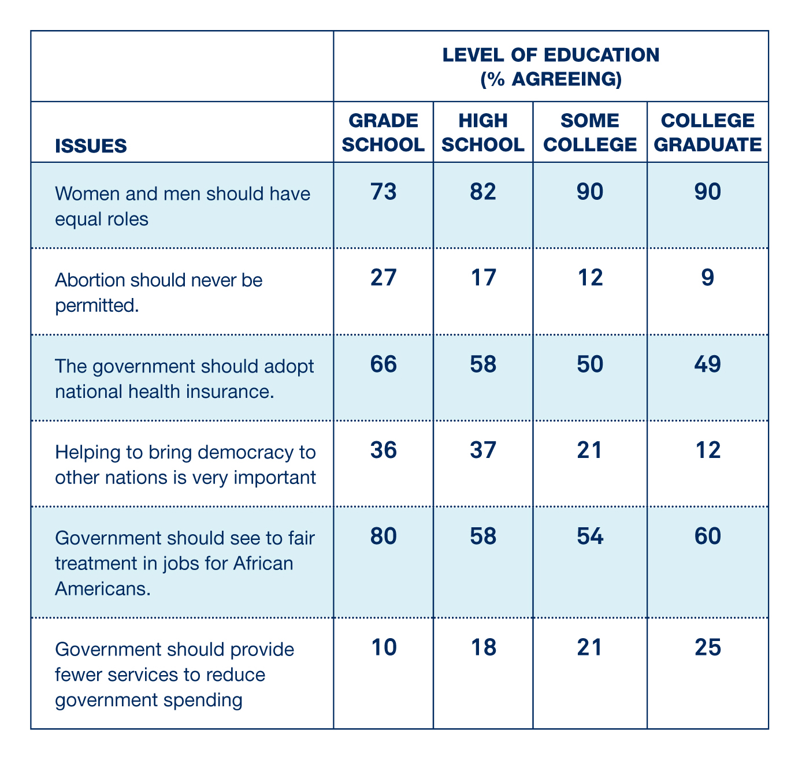
Education and Public Opinion

Slide 12
Political Ideology
Ideology is a comprehensive way of understanding political or cultural situations
It is a set of assumptions about the way the world and society works that help us organize our beliefs, information, and new situations
Most Americans describe themselves as either liberals or conservatives

Slide 13
Conservatives and Liberals
Conservatives
Liberals
Support the social and economic status quo
Suspicious of efforts to introduce new political formulas and economic arrangements
Believe that a large and powerful government poses a threat to citizens’ freedoms
Support political and social reform
Extensive government intervention in the economy
Expansion of federal social services
More vigorous efforts on behalf of the poor, minorities, and women
Greater concern for consumers and the environment

Slide 14
Identity Politics
Political identities are distinctive characteristics or group associations that individuals carry and that hold for those individuals’ social connections or common values and interests with others in that group
Identities are both psychological and sociological
Unlike ideologies, identities are absolutes
Notes:
Discussion:
The text argues that identities are both absolutes (you identify with either one group or another; there is no in-between) and that identity politics is often zero-sum: one group wins and another loses. You might ask students to discuss these premises and see whether they agree. Can they identify overlapping identities, and can they identify ways in which identity politics might not be zero-sum?

Slide 15
Range of Social, Cultural, and Political Identities
Nationality
Partisan identification
Race/ethnicity
Gender
Religion
Geography
Outgroups

Slide 16
Race and Public Opinion
The history of slavery and racial discrimination has created a deep, lasting divide between whites on the one hand and blacks and Latinos on the other
There are stark differences in beliefs and preferences among Latinos, blacks, and whites regarding the basic responsibilities of government
Notes:
Discussion:
This is an opportunity to point out how the history principle works in practice. The differences we observe in public opinion among blacks, Latinos, and whites are largely a function of historical patterns of discrimination that have a lasting effect on the preferences and beliefs of people from different racial and ethnic groups.

Slide 17
Disagreement among Blacks and Whites

Slide 18
Changing Partisan Division in the Latino Community
Notes:
Discussion:
In the 2012 presidential race, President Obama lost among white voters by about 20 points (59–39), and the Latino vote was crucial, mainly because it is the fastest-growing group in the country and because there are large numbers of Latinos in key swing states such as Arizona, New Mexico, Nevada, Colorado, and Florida. But as these data show, Latino voters are not a solid “bloc” but rather an umbrella name for a number of subgroups that have divergent preferences on issues, the parties, and candidates. In 2008, the Republican advantage among Cuban voters disappeared, and in 2012 the Democratic advantage among Latinos generally grew. While Latino voters strongly supported Hillary Clinton in 2016, there is some dispute over how big the margin was and whether Latinos moved even further toward the Democratic Party or whether Donald Trump and Republicans made some slight gains among Latino voters.

Slide 19
Gender and Public Opinion
Gender gap—a distinctive pattern of voting behavior reflecting the differences in views between women and men
The gender gap has been an enduring feature of American elections for some time, with women consistently voting more Democratic and men voting more Republican

Slide 20
Gender Gap on War and Peace

Slide 21
Religion, Geography, and Public Opinion
Religion shapes peoples’ values and beliefs and also serves as a strong identity
Where we live also molds our sense of identity—regional accents, state pride, and history all play a role
Notes:
Discussion:
Again, the history principle plays a role in understanding how geography shapes our political identities. The lasting impact of the history of the Civil War and, even before that, what Alexis de Tocqueville viewed as America’s two separate foundings shape how southerners have a distinctive political identity from those living in the northeast.

Slide 22
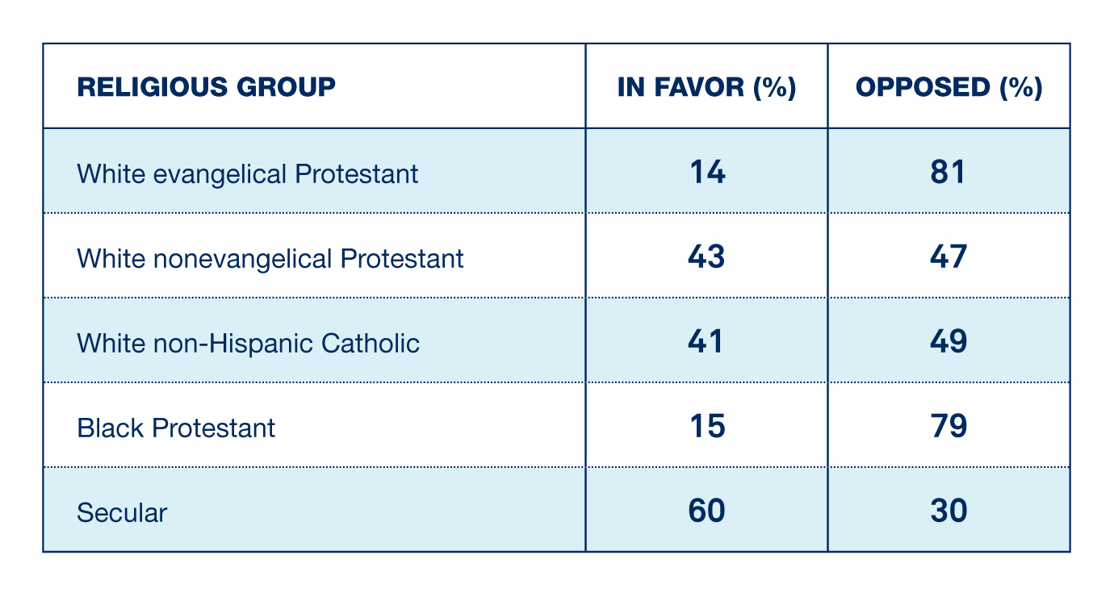
Religious Groups and Same-Sex Marriage

Slide 23
Agents of Socialization: Political Conditions
The conditions under which individuals and groups come of political age also shape political orientation
Similarly, the views of individuals and groups change as the political conditions change

Slide 24
Public Opinion and Political Knowledge
Few Americans devote sufficient time, energy, or attention to politics to really understand all the issues
The costs of gathering information may be high, and the benefits may be low
We can think of examples, however, in which low levels of political information can be harmful to groups of people

Slide 25
Public Opinion and Political Knowledge: Stability
Knowledge and instability: low levels of information lead to instability and incoherence in responses to surveys
Others argue there is great stability in public opinion
Notes:
Discussion:
This discussion is a good example of the rationality principle in action. Political scientists may not like it, but some citizens may come to the rational conclusion that having lots of political information does them no good. While having a lot of information may not necessarily help, low levels of information can be harmful. The political scientist Larry Bartels points out that millions of Americans unlikely to benefit from George W. Bush’s tax proposals supported his tax cuts regardless because they mistakenly thought that they would. Bartels calls this phenomenon “misplaced self-interest.” Some, as far back as the Marquis de Condorcet, have argued that all this is not necessarily a problem for democratic politics, as aggregation of opinion at a mass level counteracts the effects of political ignorance. In the 2016 election, political knowledge and education played a significant role, as Donald Trump performed significantly better than Mitt Romney had among voters with less than a college degree while Hillary Clinton performed far better than Barack Obama had in 2012 among voters with a college degree or more. Nate Silver, editor of FiveThirtyEight.com, showed that Clinton’s vote surged in the most highly educated counties in America while Trump’s vote surged in the least-educated counties: http://fivethirtyeight.com/features/education-not-income-predicted-who-would-vote-for-trump/.

Slide 26
Shaping Opinion: Government and Politicians
All governments attempt to influence citizens’ beliefs, but their efforts are counteracted by interest groups, media, and politicians opposed to those in power
Presidents have been actively “going public” for decades to influence how the public perceives their policy initiatives
They are not always successful, however

Slide 27
Shaping Opinion: Private Groups
Following the rationality principle, groups and individuals seek to influence latent, unorganized individuals to support their cause
Groups and individuals with more money, institutional support, and skill will have more success
Notes:
Discussion:
In 2011, Stephen Colbert formed his own Super PAC, but knowing that he did not necessarily have the skill to market his ideas to the public, he sat down with Frank Luntz, a Republican political consultant, for advice. Luntz helped Colbert come up with ways to market his ideas. The video of the interview can be found here: http://www.cc.com/video-clips/m00z1i/the-colbert-report-colbert-super-pac---frank-luntz-commits-to-the-pac.

Slide 28
Shaping Opinion: Media
The mass media are the conduits through which most politically relevant information flows to the public
Traditional media sources—newspapers, radio, and television—are supplemented today by the Internet and social media
We learn from the media actively (seeking out news) and passively (absorbing news through entertainment)

Slide 29
Media Effects: Agenda Setting, Priming, and Framing
Agenda setting—the power to bring attention to particular issues and problems
Priming—the process of preparing the public to take a particular view of an event or a political actor
Framing—the power of the media to influence how events and issues are interpreted

Slide 30
Clicker Question 5
A decision to lead a broadcast with a story about a high-profile murder case rather than the president’s trip to the Middle East is an example of a media effect called
agenda setting.
priming.
framing.
Notes:
Answer: A. agenda setting.

Slide 31
Clicker Question 5 (Answer)
A decision to lead a broadcast with a story about a high-profile murder case rather than the president’s trip to the Middle East is an example of a media effect called
agenda setting.
priming.
framing.
Notes:
Answer: A. agenda setting.

Slide 32
Measuring Public Opinion
A poll is a scientific instrument for measuring public opinion
A century ago, political leaders utilized imperfect measures of public opinion such as crowd size and the applause they could hear
Political leaders use polls to determine whether to run for office, what policies to support, and how to make appeals

Slide 33
Measuring Public Opinion: Samples
A sample is a small group selected to represent the most important characteristics of an entire population
In order to get a random sample in national polls, pollsters often use random-digit dialing, in which a random-number generator produces a list of as many 10-digit phone numbers as the pollster deems necessary
Notes:
Discussion:
Surveys that do not use random samples can provide wildly misleading results. After the first general election presidential debate in 2016, Donald Trump claimed he had won the debate according to all of the “online polls.” Trump was referring to polls that are not scientific that allow people (or even computers) to vote many times. In short, they were not based on a representative sample of debate watchers. John Oliver discussed the issue in a segment on Last Week Tonight: https://www.youtube.com/watch?v=v9FBMYBaMsg.

Slide 34
Measuring Public Opinion: Selection Bias
Selection bias is a polling error in which the sample is not representative of the population being studied
Finding a representative sample is not easy, and we have to avoid selection bias
Notes:
Discussion:
One of the most important current issues that pollsters face is that random-digit dialing is less and less successful because of innovations like Caller ID and because lists of mobile phone numbers are more expensive to purchase. Because of Caller ID, many respondents will not answer the phone, and the people who use Caller ID to screen calls are not randomly distributed. In other words, Caller ID introduces selection bias. In addition, more and more homes do not have an active landline phone, so unless the survey compensates for this by calling mobile phones as well, there is a problem with selection bias. Selection bias is also an issue in some polls, particularly in states with large Hispanic populations, that do not conduct any interviews in Spanish for voters who do not speak English.

Slide 35
Measuring Public Opinion: Sample Size
The reliability of a poll is also partly a function of sample size
The larger the sample size, the less likely the result will be due to sampling error—a polling error that arises on account of small sample size
But larger samples are more expensive

Slide 36
Accuracy of Final Pre-Election Polls
Notes:
Discussion:
Despite its various difficulties, polling has become fairly accurate, particularly on questions such as preference of presidential candidates, where the question is highly salient and voters have high levels of information. That said, Figure 10.3 shows that most of the national polls overestimated the size of Hillary Clinton’s lead in the popular vote.

Slide 37
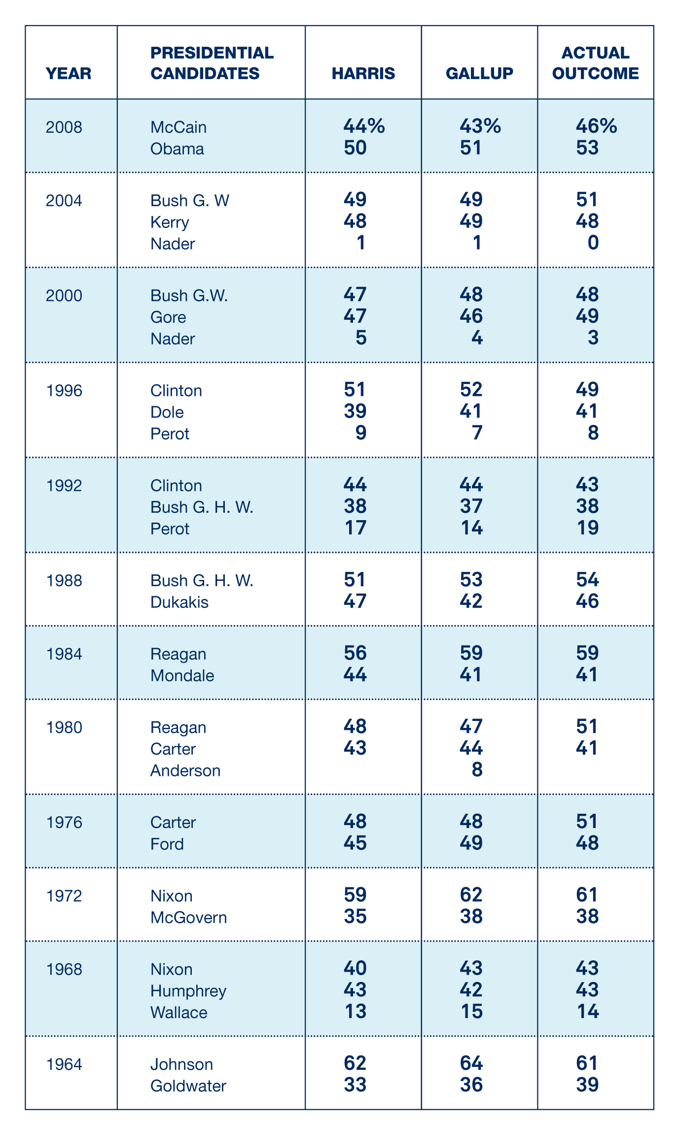
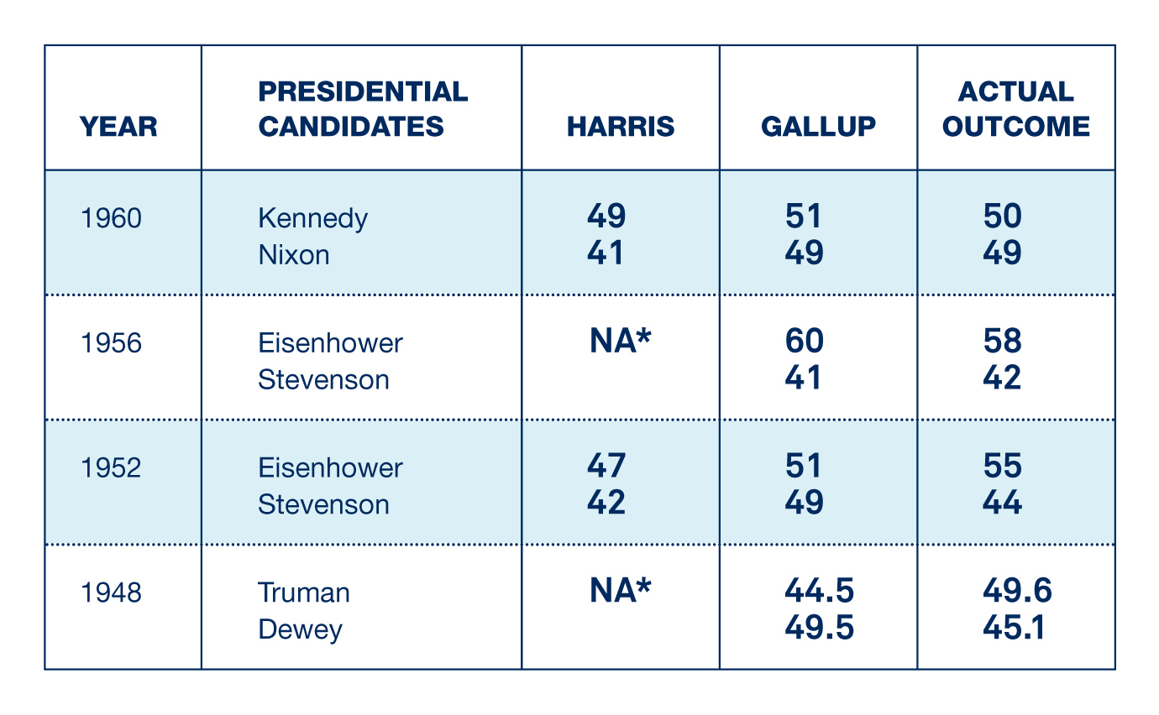
Two Pollsters and Their Records

Slide 38
Measuring Public Opinion: Survey Design
Even with a large, representative sample, a poll may provide a misleading result or measurement error
Measurement error is the failure to identify the true distribution of opinion within a population because of errors such as ambiguous or poorly worded questions
Notes:
Discussion:
A different example of a theory of measurement error is the so-called Bradley effect. During the 2008 campaign, there were some who believed that polls were overestimating then-Senator Barack Obama’s support because, out of a fear that they might appear prejudiced if they were not supporting a black candidate, polling respondents would tell pollsters they were supporting Obama. This idea was referred to as the Bradley Effect because polls in Tom Bradley’s 1982 campaign for mayor of Los Angeles had suggested he was much further ahead than the eventual margin of his victory. It turned out that the Bradley effect was pure mythology. Similarly, in 2016, many argued there might be “shy Trump voters” who were not showing up in public polling. There does not appear to have been any such effect in national polls, though it is the case that Trump’s support in some key Midwestern swing states was understated in state-level polls.

Slide 39
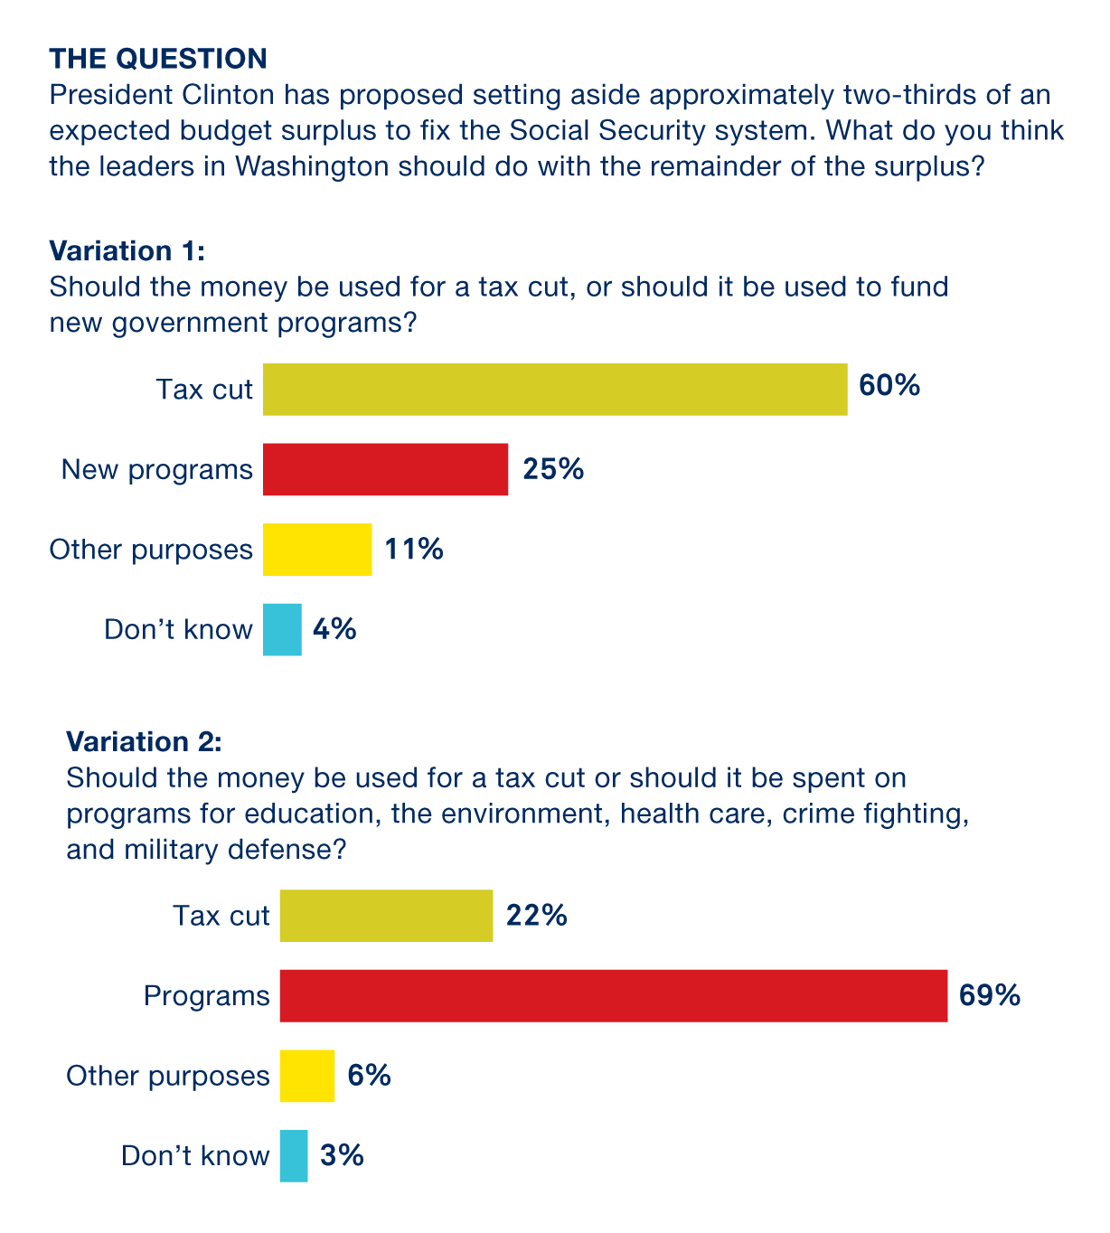
The Questions Matter

Slide 40
The Questions Matter

Slide 41
How Does Public Opinion Influence Government Policy?
Three important ways:
Electoral accountability
Building coalitions: public bills are more likely to pass if they have public support
Input in rule making and legal decisions

Slide 42
Clicker Question: Review
Which of the following is NOT an important problem in measuring public opinion?
poorly worded questions
small sample size
the Bradley effect
sampling bias
Notes:
Answer: C. the Bradley effect

Slide 43
Clicker Question: Review (Answer)
Which of the following is NOT an important problem in measuring public opinion?
poorly worded questions
small sample size
the Bradley effect
sampling bias
Notes:
Answer: C. the Bradley effect

Slide 44
Government and the Will of the People
Representative democracy requires that the preferences of the people be translated into action
But identifying and measuring those preferences is not simple or easy
And the diversity and size of the republic means a lack of consensus is common

Slide 45
Additional Information
Following this slide, you will find additional images, figures, and tables from the textbook.

Slide 46
Public Opinion and Reforming Social Security
Notes:
Demonstrators protest Social Security reform proposed in 2005.

Slide 47
Analyzing the Evidence: The Contact Hypothesis 1
Notes:
Americans’ attitudes toward gay rights have evolved significantly over the past 20 years. In 1996, opponents of gay marriage in the United States greatly outnumbered supporters by 65 to 27 percent. By 2015, the year the U.S. Supreme Court established the right to marry for gay couples in Obergefell v. Hodges, Americans favored gay marriage by 56 to 39 percent.
What explains this change in attitudes? A theory from social psychology known as the contact hypothesis holds that certain types of contact between in-group and out-group members reduces the stigma directed toward the out-group. In this case, are straight people (the in-group) who know openly gay people (the out-group) more supportive of gay rights? The graphs show that support for gay rights has increased at the same time that more Americans have reported knowing gays and lesbians who have told them personally.
Furthermore, those who report having gay friends are indeed significantly more supportive of gay rights than those who do not. We can see this by creating a composite score for survey respondents based on their opinions on such issues as gay marriage, adoption, and job discrimination. A score of 100 is fully supportive of all gay rights. Those with gay friends score an estimated 43 on the scale; those who report having no gay friends score only 36 (see the third graph featured).
But can we be sure that contact with gay people is actually causing increased support for gay rights? One concern is selection bias. Gay people may be selective about disclosing their identity to those friends whom they already know to be supportive, and straight people who hold more tolerant attitudes may be more likely to select gay people as friends.
To further explore this question, we can examine types of contact that are governed less by selection. While we typically do chose our friends, co-workers and family members are essentially chosen for us. These types of contacts thus offer much cleaner tests of the contact hypothesis. As shown in the bar graph above, in these contexts the effect of contact on attitudes is essentially zero (i.e., individuals with gay co-workers or gay family members are no more supportive of gay rights than those without).
This evidence thus runs counter to the contact hypothesis. But it does not entirely settle the question, and some political scientists have presented results in support of the hypothesis. When political scientists find evidence against a hypothesis, they consider different theories. For example, it may be that it is not the type but the quality of contact that changes attitudes. Definitive answers to these questions await discovery through additional research.

Slide 48
Analyzing the Evidence: The Contact Hypothesis 2
Notes:
Americans’ attitudes toward gay rights have evolved significantly over the past 20 years. In 1996, opponents of gay marriage in the United States greatly outnumbered supporters by 65 to 27 percent. By 2015, the year the U.S. Supreme Court established the right to marry for gay couples in Obergefell v. Hodges, Americans favored gay marriage by 56 to 39 percent.
What explains this change in attitudes? A theory from social psychology known as the contact hypothesis holds that certain types of contact between in-group and out-group members reduces the stigma directed toward the out-group. In this case, are straight people (the in-group) who know openly gay people (the out-group) more supportive of gay rights? The graphs show that support for gay rights has increased at the same time that more Americans have reported knowing gays and lesbians who have told them personally.
Furthermore, those who report having gay friends are indeed significantly more supportive of gay rights than those who do not. We can see this by creating a composite score for survey respondents based on their opinions on such issues as gay marriage, adoption, and job discrimination. A score of 100 is fully supportive of all gay rights. Those with gay friends score an estimated 43 on the scale; those who report having no gay friends score only 36 (see the third graph featured).
But can we be sure that contact with gay people is actually causing increased support for gay rights? One concern is selection bias. Gay people may be selective about disclosing their identity to those friends whom they already know to be supportive, and straight people who hold more tolerant attitudes may be more likely to select gay people as friends.
To further explore this question, we can examine types of contact that are governed less by selection. While we typically do chose our friends, co-workers and family members are essentially chosen for us. These types of contacts thus offer much cleaner tests of the contact hypothesis. As shown in the bar graph above, in these contexts the effect of contact on attitudes is essentially zero (i.e., individuals with gay co-workers or gay family members are no more supportive of gay rights than those without).
This evidence thus runs counter to the contact hypothesis. But it does not entirely settle the question, and some political scientists have presented results in support of the hypothesis. When political scientists find evidence against a hypothesis, they consider different theories. For example, it may be that it is not the type but the quality of contact that changes attitudes. Definitive answers to these questions await discovery through additional research.

Slide 49
Analyzing the Evidence: The Contact Hypothesis 3
Notes:
Americans’ attitudes toward gay rights have evolved significantly over the past 20 years. In 1996, opponents of gay marriage in the United States greatly outnumbered supporters by 65 to 27 percent. By 2015, the year the U.S. Supreme Court established the right to marry for gay couples in Obergefell v. Hodges, Americans favored gay marriage by 56 to 39 percent.
What explains this change in attitudes? A theory from social psychology known as the contact hypothesis holds that certain types of contact between in-group and out-group members reduces the stigma directed toward the out-group. In this case, are straight people (the in-group) who know openly gay people (the out-group) more supportive of gay rights? The graphs show that support for gay rights has increased at the same time that more Americans have reported knowing gays and lesbians who have told them personally.
Furthermore, those who report having gay friends are indeed significantly more supportive of gay rights than those who do not. We can see this by creating a composite score for survey respondents based on their opinions on such issues as gay marriage, adoption, and job discrimination. A score of 100 is fully supportive of all gay rights. Those with gay friends score an estimated 43 on the scale; those who report having no gay friends score only 36 (see this graph).
But can we be sure that contact with gay people is actually causing increased support for gay rights? One concern is selection bias. Gay people may be selective about disclosing their identity to those friends whom they already know to be supportive, and straight people who hold more tolerant attitudes may be more likely to select gay people as friends.
To further explore this question, we can examine types of contact that are governed less by selection. While we typically do chose our friends, co-workers and family members are essentially chosen for us. These types of contacts thus offer much cleaner tests of the contact hypothesis. As shown in the bar graph above, in these contexts the effect of contact on attitudes is essentially zero (i.e., individuals with gay co-workers or gay family members are no more supportive of gay rights than those without).
This evidence thus runs counter to the contact hypothesis. But it does not entirely settle the question, and some political scientists have presented results in support of the hypothesis. When political scientists find evidence against a hypothesis, they consider different theories. For example, it may be that it is not the type but the quality of contact that changes attitudes. Definitive answers to these questions await discovery through additional research.

