Slide 1
American Government
Power and Purpose
Lowi, Ginsberg, Shepsle, Ansolabehere
The Presidency as an Institution
Chapter 7

Slide 2
The Presidency as Paradox
The eight presidents prior to President Obama left office under a cloud
Yet many aspire to the office, and the president is perceived to be all-powerful
One explanation for this paradox is that the presidency is the one unitary institution in the federal government
“I am the decider.” —George W. Bush
Notes:
Discussion:
Concerning the 2012 election, it is worth asking students why they think Barack Obama sought reelection and whether they think he enjoyed his second term. Similarly, it is useful to ask students what they make of the fact that the 2016 election came down to two exceedingly unpopular candidates and what they think Mr. Trump’s governing prospects will be given his high unfavorable ratings.

Slide 3
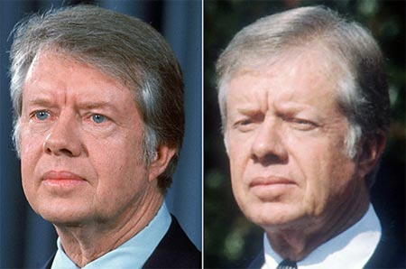
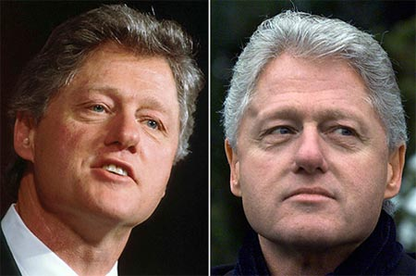
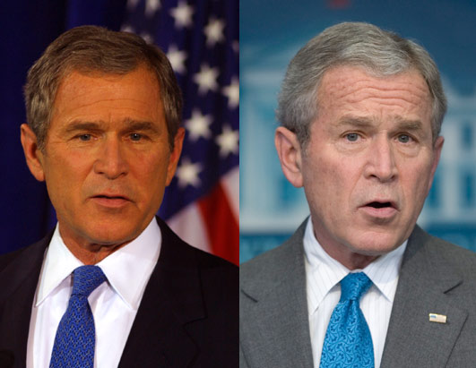
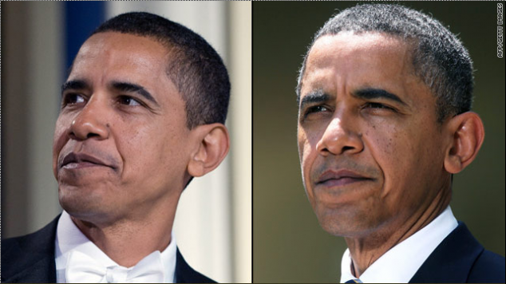

Slide 4
The Constitutional Basis of the Presidency: Article II
Article II of the Constitution begins by asserting, “The executive Power shall be vested in a President of the United States of America”
Two important elements:
  What “the executive power” is has remained a matter of dispute
  Power is vested in “a” president, thus establishing the unitary nature of the office
Notes:
Discussion:
While the powers of the president in Article II are no match for the powers of Congress listed in Article I, Section 8, the unitary nature of the office is the presidency’s great advantage. In addition, the vagueness of the “executive power” provided room for growth in presidential power over time.

Slide 5
The Constitutional Basis of the Presidency: Selection
The president is chosen by the Electoral College, a somewhat indirect and undemocratic institution originally intended to provide a system of peer review for presidential selection
Some of the elements of this system of peer review have been eroded over time, but the Electoral College remains in place
Notes:
Discussion:
Students usually enjoy detailed discussion of the Electoral College and how it works. Jon Stewart’s America has a good audio clip pointing out that the Electoral College can sometimes produce a president who did not win the popular vote, which is a technicality that “a lonely, unemployed Al Gore muses on each and every night as he cries himself to sleep.” Of course, Hillary Clinton recently became the second Democrat in 16 years to win the popular vote and lose in the Electoral College. In Clinton’s case, her more than 3 million popular vote victory represents the largest popular vote margin of victory ever for a candidate who lost the popular vote, and it is the largest victory in percentage terms for someone who lost the Electoral since Samuel Tilden’s loss in 1876 (Tilden won the popular vote by 3 percent).

Slide 6
Electoral College
Odd system, but makes sense when you think about the context of the late 18th century
Balances concerns of president being beholden to the legislature.
Led to vice-president and political parties.
Can (and has) resulted in candidates with less than a majority of the popular vote winning.
What are the alternatives?

Slide 7
The Constitutional Powers of the Presidency: Article II
Expressed powers—specific powers granted to the president under Article II
Delegated powers—constitutional powers that are assigned to one government agency but exercised by another agency with the express permission of the first
Inherent powers—powers claimed by a president that are not expressed but are inferred from it

Slide 8
Clicker Question 1
The president’s power to propose a budget every year is which of the following?
expressed power
delegated power
inherent power
Notes:
Answer: B. delegated power
Congress delegated power to the president to propose an executive budget in the Budget and Accounting Act of 1921. However, the power could also be inferred from the president’s power to “give to the Congress Information of the State of the Union, and recommend to their Consideration such Measures as he shall judge necessary and expedient.”

Slide 9
Clicker Question 1 (Answer)
The president’s power to propose a budget every year is which of the following?
expressed power
delegated power
inherent power
Notes:
Answer: B. delegated power
Congress delegated power to the president to propose an executive budget in the Budget and Accounting Act of 1921. However, the power could also be inferred from the president’s power to “give to the Congress Information of the State of the Union, and recommend to their Consideration such Measures as he shall judge necessary and expedient.”

Slide 10
Expressed Powers 1
Military
  Article II gives the president the title of commander in chief
  Presidents have effectively used this title as the power to make war
Judicial: may grant pardons and amnesty
Diplomatic
  Negotiate treaties
  May receive foreign ambassadors
Notes:
Discussion:
Students are always particularly interested in a discussion of presidential war powers, the War Powers Resolution, and the role of these powers in the War on Terror. One interesting case worthy of discussion was the recent NATO military action in Libya and the dispute between the Obama administration and some members of Congress over whether this military action should have been governed by the provisions of the War Powers Resolution. This debate is covered well by the New York Times in an article reporting on the Obama administration’s claim that the War Powers Resolution did not apply to military action in Libya: http://www.nytimes.com/2011/06/16/us/politics/16powers.html?pagewanted=all.

Slide 11
Expressed Powers 2
Executive
  The president “shall take Care that the Laws be faithfully executed”
  The president may nominate executive and judicial officials
Legislative
  The president gives information to Congress and recommends measures
  The veto
Notes:
Discussion:
As the text explains (pp. 248–53), presidential use of the veto is highly contextual (used more during divided government for instance) and, even when used infrequently, remains consequential. Presidents use veto threats to influence legislation before it reaches their desk.

Slide 12
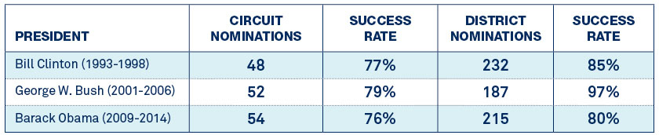
Nominations to Federal Courts

Slide 13
Executive Privilege
The claim that confidential communications between the president and the president’s closest advisers should not be revealed without the consent of the president
In U.S. v. Nixon, the Court recognized the validity of executive privilege but argued it did not apply in the case of Nixon’s White House tapes
Notes:
Discussion:
In 2012, the Obama administration claimed executive privilege in refusing to comply with a subpoena from the House of Representatives for documents related to “Operation Fast and Furious.”

Slide 14
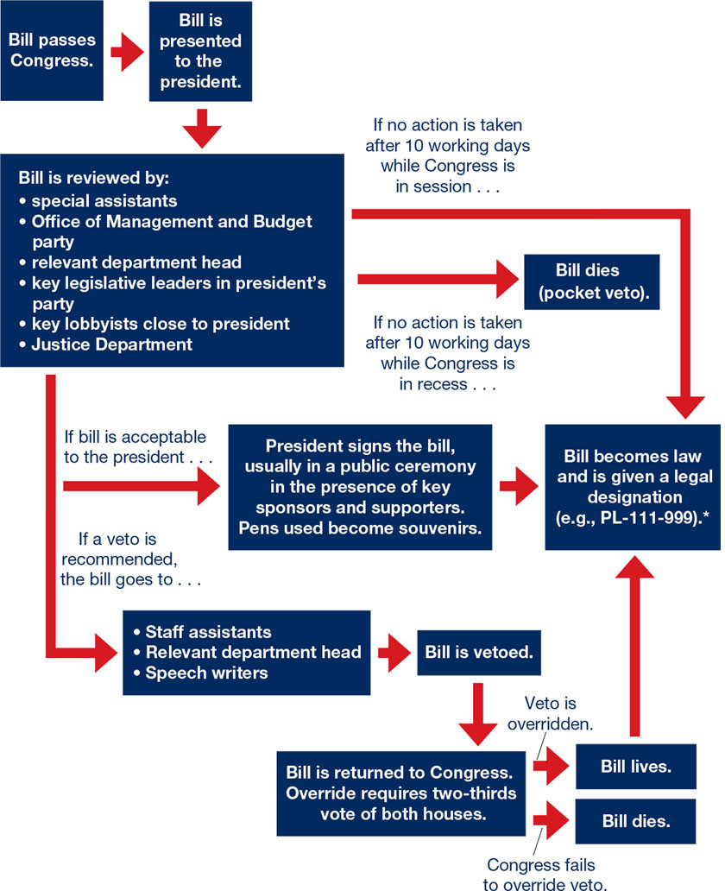
The Veto Process

Slide 15
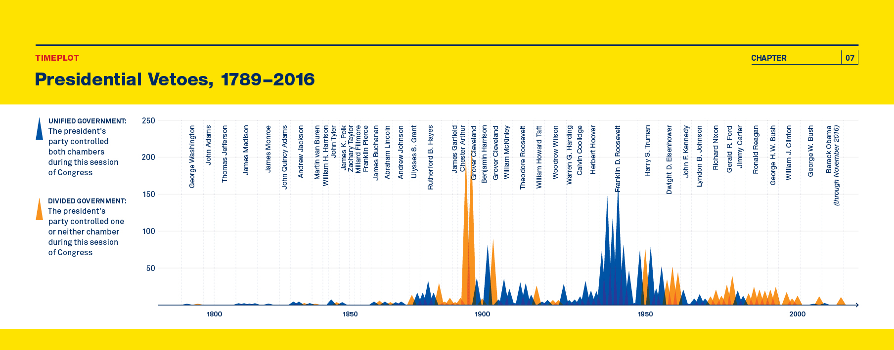
Presidential Vetoes
Notes:
Discussion:
As the text points out, “The politics surrounding the veto is complicated, and it is usually part of an intricate bargaining process between the president and Congress, involving threats of vetoes, the repassage of legislation ,and second vetoes.” As the data in the chart above shows, divided government and the more polarized era of governance today have not led to more actual vetoes. But that does not mean the veto has become less consequential, and vetoes are rarely overridden. The only veto override in President Obama’s eight years as president concerned the question of sovereign immunity and, more specifically, whether 9/11 families could sue Saudi Arabia.

Slide 16
Delegated Powers
Congress creates agencies by law, and these agencies use discretion in how they carry out their functions
The president is sometimes given authority directly and sometimes indirectly through the power to appoint agency officials

Slide 17
Inherent Powers
War powers: the president’s power to make war
Legislative initiative—the president’s power to bring a legislative agenda before Congress
Executive order—a rule or regulation issued by the president that has the effect of legislation

Slide 18
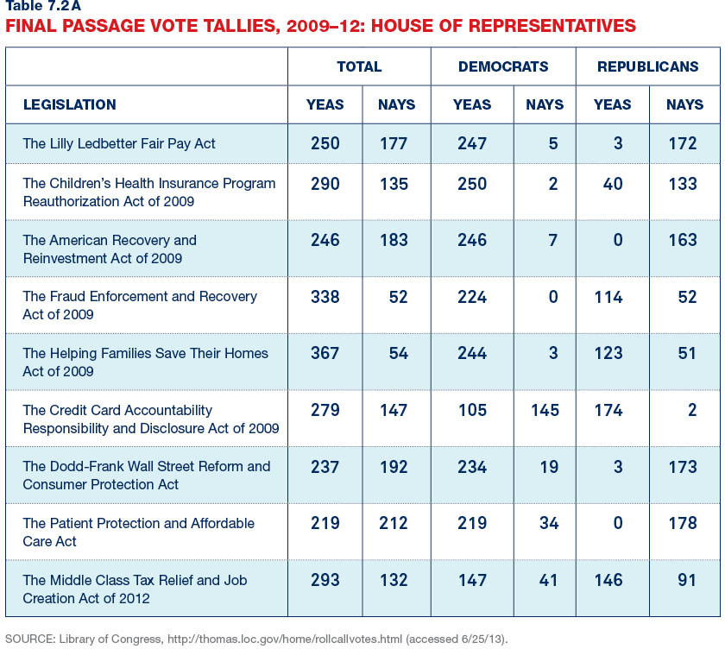
Obama and Legislative Initiative:
House of Representatives

Slide 19
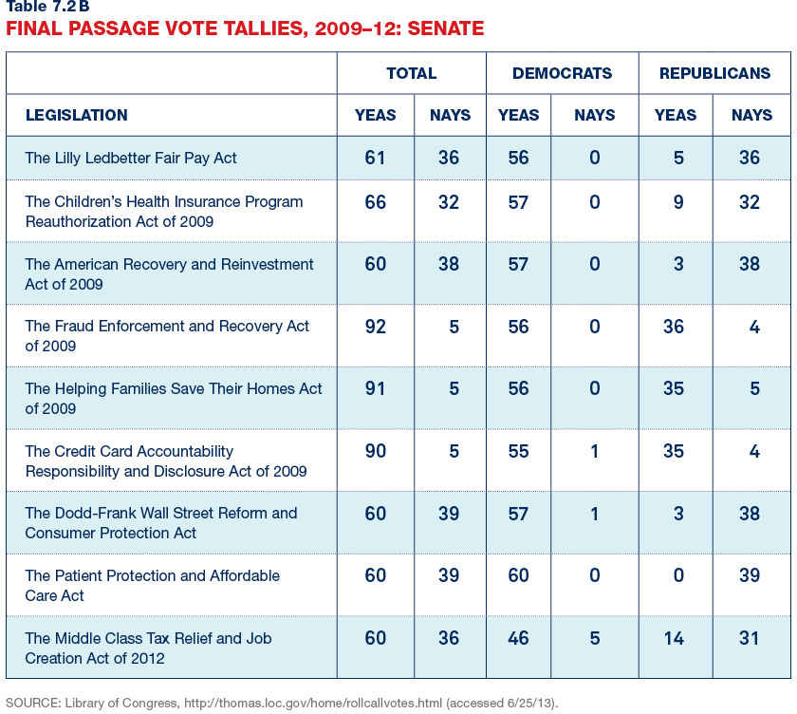
Obama and Legislative Initiative:
Senate

Slide 20
The Legislative Epoch:
1800–1933
Presidential power has varied over time and among particular occupants of the office
Most of our institutional history (1800–1933) can be described as “the legislative epoch”—an era when Congress dominated national policy making
Notes:
Discussion:
There are many ways to communicate to students how different the legislative epoch was from the presidency-centered political system we have today. One way to do this is to ask students how many presidents they can name who served between Abraham Lincoln and Theodore Roosevelt (basically, the late nineteenth century) and then ask students to identify any of the significant accomplishments of any of these presidents. Figures such as Chester Arthur and Grover Cleveland are good examples of the weakness of the institution of the presidency in this era.

Slide 21
The New Deal and the Presidency
The New Deal introduced new interventions in economic life and regulation by the federal government that necessarily meant a larger role in governance for the chief executive
This larger role for the president has only expanded since the New Deal

Slide 22
Presidential Government:
Formal Power Resources
Cabinet—the secretaries, or chief administrators, of the major departments of government report to the president
White House staff—analysts and advisers who work directly for the president
Executive Office of the President—permanent agencies that perform defined management tasks for the president
Vice president
Notes:
Discussion:
The rise of the institutional presidency has meant that the presidency has become more of a “thing” and less of a “person” over time. While most of the individuals who make up the cabinet, the White House staff, EOP, and the Office of the Vice President change from presidency to presidency, it is important to note that these structures remain; they have become institutionalized, so the president is more of a large organization than an individual as it was in the nineteenth century.

Slide 23
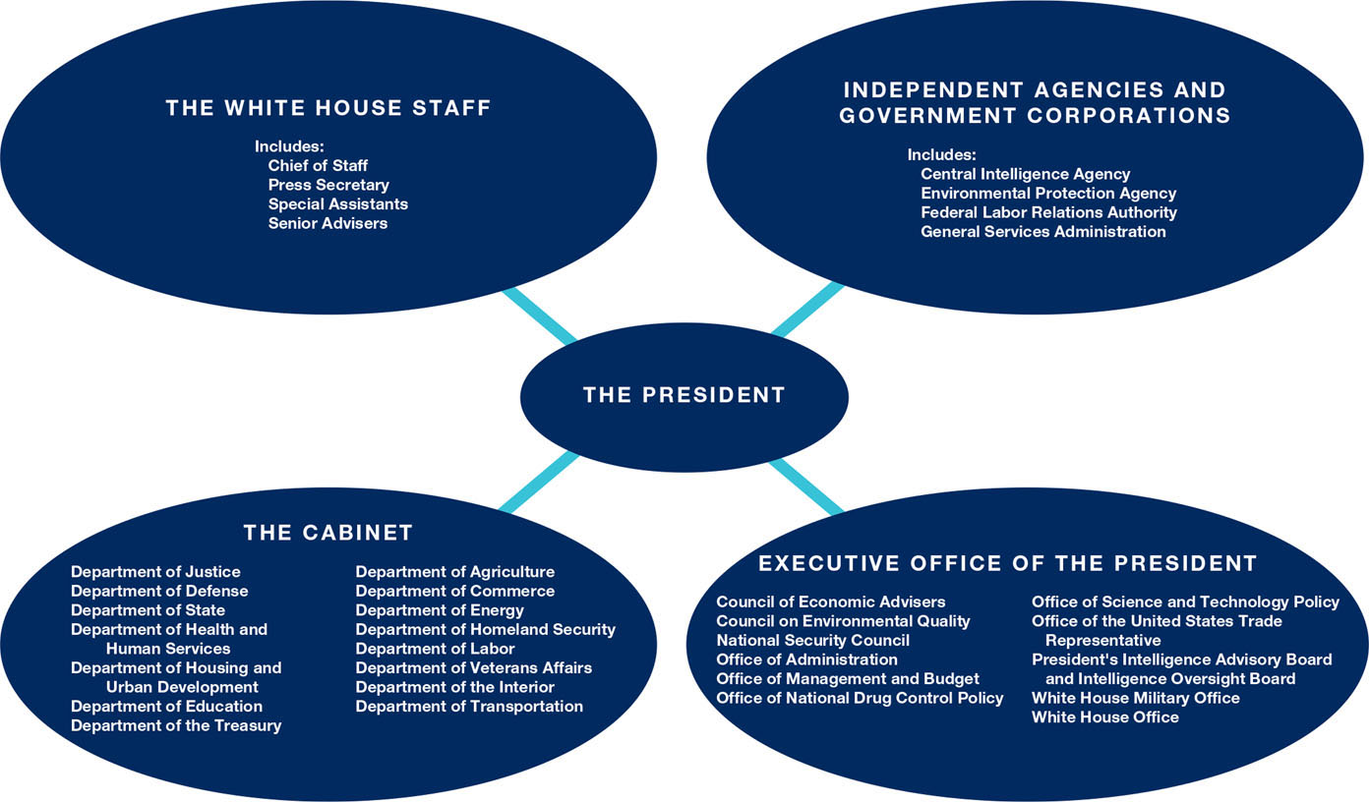
The Institutional Presidency

Slide 24
The Contemporary Bases of Presidential Power: Parties
Presidents rely on their partisans for help, but presidents cannot control their party
In 2009 and 2010, President Obama had large Democratic majorities in both chambers of Congress; after that, he had to “negotiate” with congressional Republican majorities
In 2017, the Trump administration is working with Republican majorities
Notes:
Discussion:
Even when presidents have majorities of their own party controlling both chambers of Congress, there are fissures within the majority coalition that make it difficult to accomplish everything they’d like. In addition, the power of the minority to filibuster in the Senate limits the power of even a unified president and his or her congressional party.

Slide 25
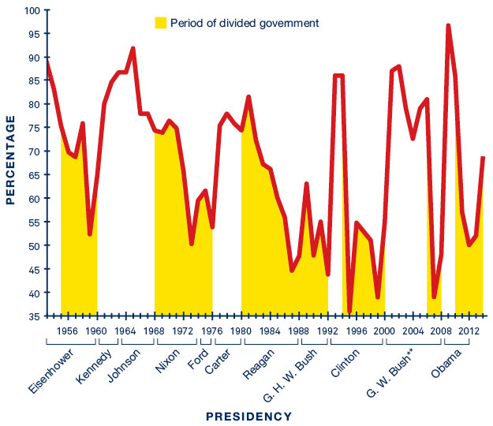
Presidential Success on Congressional Votes
Notes:
Discussion:
Presidents obviously have much more success when their party controls both chambers of Congress. But even in those cases, presidential success varies widely. Note how successful President Reagan was with divided government at some points in his presidency and how unsuccessful he was at other times.

Slide 26
Contemporary Bases of Presidential Power: Going Public
Going public is a tactic by which presidents seek to force members of Congress to support their policies by appealing directly to and mobilizing the public
Presidents increasingly went public throughout the twentieth century through speeches, radio, television, and now the Internet
Notes:
Discussion:
In an era of ideologically polarized parties and divided government, it appears that going public is yielding diminishing returns.

Slide 27
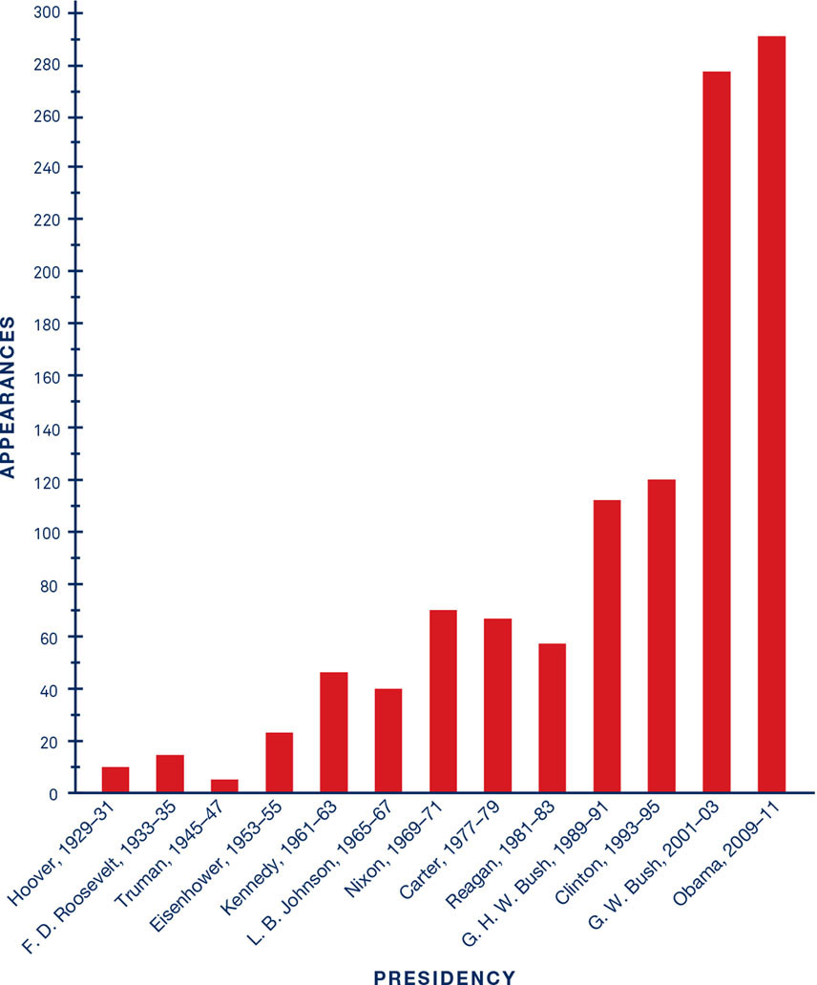
Public Appearances by Presidents

Slide 28
Contemporary Bases of Presidential Power: Personal President
As presidents increasingly went public, their personal characteristics and skills became more important
For instance, Ronald Reagan’s success in divided government was attributed to his ability to communicate through television, a skill he honed as an actor
  http://www.youtube.com/watch?v=xfZg4UIuZe4
Notes:
Discussion:
Reagan’s remarkable ability to communicate through television can be seen in this video of his address to the nation on the day the Space Shuttle Challenger was lost: http://www.youtube.com/watch?v=Qa7icmqgsow.
Every president’s personal characteristics are a focus of much discussion as a source of power or lack of power. President Obama has sometimes been criticized for being too aloof and for failing to get “angry” enough. President Obama poked fun at himself in this regard by inviting “Luther,” his anger translator, to the White House Correspondents’ Dinner: https://www.youtube.com/watch?v=G6NfRMv-4OY.

Slide 29
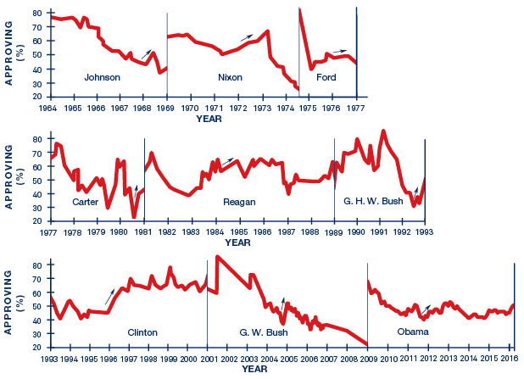
The Personal President and Approval Ratings
One of the problems of the rise of the personal presidency is that presidents seem to become less popular over time
Notes:
Discussion:
Like most two-term presidents, President Obama’s popularity rose at the end of his second term.
One of the reasons presidential approval ratings tend to decline over time is because presidential candidates have to promise a great deal to get elected but often find it difficult to deliver on all of these promises. SNL poked fun at the idea of Donald Trump learning this lesson in the weeks after his surprising election in 2016: https://www.youtube.com/watch?v=JUWSLlz0Fdo.

Slide 30
Contemporary Bases of Presidential Power: Administrative State
As the limits of going public have become more apparent, contemporary presidents have turned more and more to their executive powers to achieve policy goals
  Increasing size and importance of EOP
  Increasing use of regulatory review
  Increasing directives to agencies through executive orders
  Increasing use of signing statements
Notes:
Discussion:
The use of these administrative strategies is not always successful. For one, federal courts have struck down unilateral actions by the president. Also, members of Congress have been increasingly vocal and concerned about unilateral presidential action. Finally, these executive actions do not quite have the same staying power as laws passed by Congress. Future presidents can reverse executive orders and seek to roll back other executive actions in time.

Slide 31
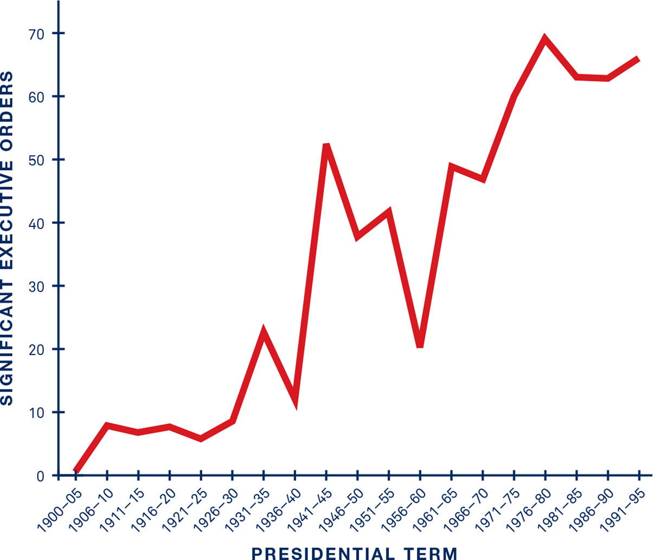
Significant Executive Orders

Slide 32
Clicker Question 3
Is the rise of presidential power good for democracy?
Yes! The president is more directly accountable because it is a unitary institution and more highly visible.
No! The president cannot possibly represent the views of 330 million Americans and is hard to hold accountable.
Notes:
Answer: No right answer
This might be a good question to use as an out-of-class writing assignment requiring students to integrate concepts and evidence from the chapter into their argument.

Slide 33
Presidential Power:
Myths and Realities 1
Myth 1: Executive superiority in national emergencies—presidents are the only ones who can act quickly in an emergency
  Congress has not been an obstacle to expeditious action
  Presidents may use emergency power for other purposes
Notes:
Discussion:
Each of these points can be made part of a discussion or writing assignment about the rise of presidential power.

Slide 34
Presidential Power:
Myths and Realities 2
Myth 2: the public interest—the president is the one truly national actor who can act above party or personal interest
  There is rarely national consensus on policy
  There is no evidence that presidents set aside their personal concerns in favor of some abstract public good any more than senators or representatives do
Notes:
Discussion:
Each of these points can be made part of a discussion or writing assignment about the rise of presidential power.

Slide 35
Presidential Power:
Myths and Realities 3
Myth 3: presidential power and democracy—the president is the only nationally elected official who can claim to represent all the people
  The Electoral College has chosen someone who did not win the popular vote in two of the last five presidential elections
  Presidents serve lengthy four-year terms
  Presidential decision making is more private
Notes:
Discussion:
Each of these points can be made part of a discussion or writing assignment about the rise of presidential power.

Slide 36
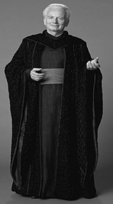
A Unilateral President
Positives – Can be beneficial for
Congress (ex: military base
closings).
President can move faster, work
more efficiently due to the lower
transaction costs.
Say one needed to end the corrupt
trade federation’s embargo of their
home planet and was frustrated by
bureaucratic delays. A unilateral
executive could deal with such a
situation quickly and efficiently.

Slide 37
A Unilateral President?
Negatives – Power can be abused
and is very difficult to get back.
It becomes difficult to get out of
wars, to respond to executive
orders or agreements or to reign in
the usage of recess appointments or
signing statements.
In short, one day you’re giving the
administration the ability to
respond to the struggling economy
and the next thing you know,
they’re blowing up Alderaan

Slide 38
Additional Information
Following this slide, you will find additional images, figures, and tables from the textbook.

Slide 39
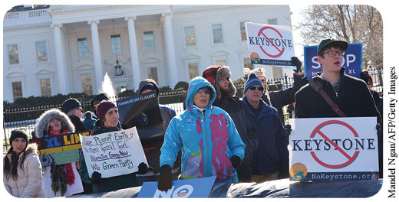
The Veto and the Keystone XL Pipeline
Notes:
Demonstrators protest the Keystone XL pipeline.

Slide 40
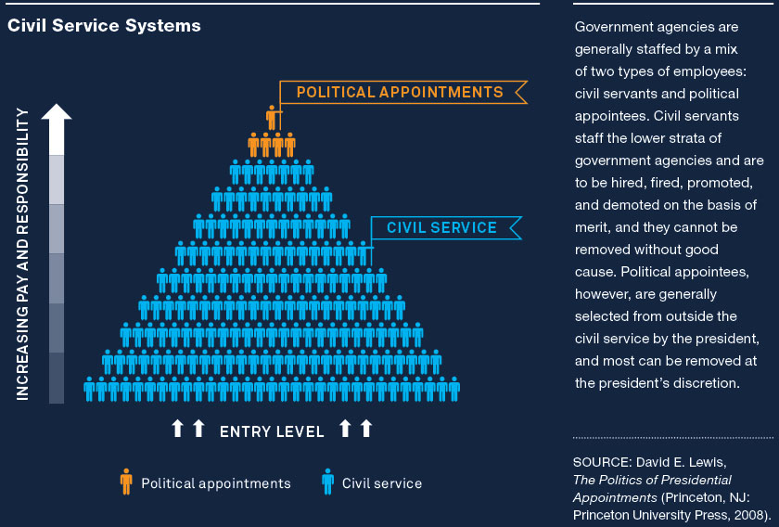
Analyzing the Evidence: The Executive Branch’s Appointees
Notes:
Article II of the Constitution states that “The executive power shall be vested in a President of the United States of America” and details one of the president’s most important constitutional roles: leading the executive branch. Today, this means the president must manage 15 cabinet departments and 55 to 60 independent agencies—and the over 2 million civilian employees who work in the federal government. Given the system of separation of powers, the president often competes with Congress for control of the executive branch. Congress also has a legitimate interest in the actions of executive branch officials since Congress creates programs and agencies and determines their budgets. The stakes of this competition between the branches are increasing. As the scope and complexity of government work have grown, Congress has delegated important policy-making responsibility to government officials working in the executive branch. These officials determine important public policies such as allowable levels of pollutants in the environment, eligibility rules for government benefits like medical care and Social Security, and safety rules in workplaces. Modern presidents have sought to exert more control over these agencies by a number of means, including increasing the number of presidential appointments.
Government agencies are generally staffed by a mix of two types of employees: civil servants and political appointees. Civil servants staff the lower strata of government agencies and are to be hired, fired, promoted, and demoted on the basis of merit, and they cannot be removed without good cause. Political appointees, however, are generally selected from outside the civil service by the president, and most can be removed at the president’s discretion.

Slide 41
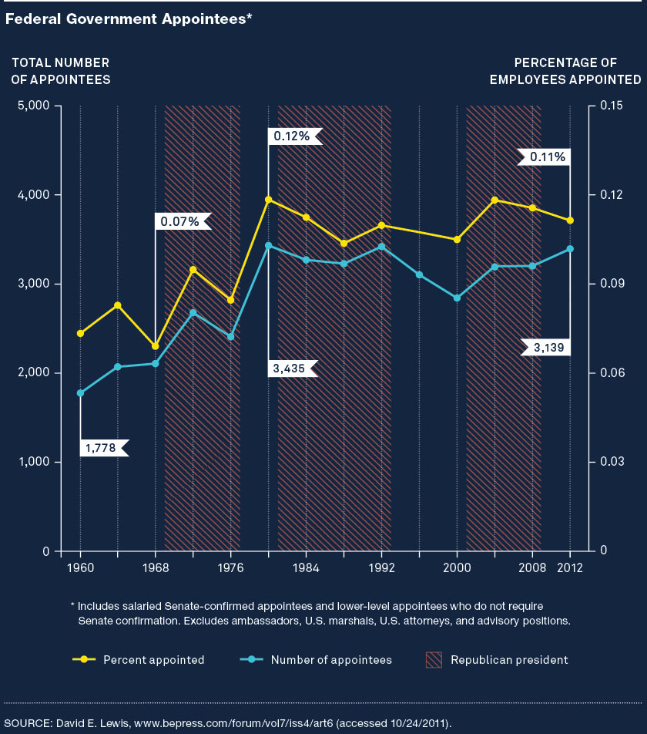
Analyzing the Evidence: Federal Government Appointees
Notes:
Presidents since the middle of the twentieth century have sought to push down the dividing line between appointees and civil servants in government agencies. The figure above presents the total number of presidential appointees as well as the percentage of appointees in the federal government workforce over the last five decades. First, it should be noted that appointees make up a very small percentage of the federal workforce. However, and interestingly, the proportion of federal employees who are appointees has grown during this time period, as presidents have tried to exert greater influence over the executive branch.

Slide 42
