Slide 1
American Government Power and Purpose
Lowi, Ginsberg, Shepsle, Ansolabehere
Civil Rights
Chapter 5

Slide 2
Civil Liberties and Civil Rights Are Not the Same
Civil rights are the legal or moral claims that citizens are entitled to make on the government
The equal protection clause of the Fourteenth Amendment has been the basis for the civil rights of African Americans, women, and other groups
Notes:
Discussion:
At the beginning of the last chapter, we distinguished between civil liberties (protections against government action) and civil rights (positive legal or moral claims that citizens are entitled to make on the government). It is useful to reinforce that distinction at the beginning of the discussion of civil rights.

Slide 3
Civil Rights and Collective Action
Remember that the collective action principle states that collective action is difficult and the difficulty mounts as the number of individuals involved increases
Civil rights shape collective action by regulating who can participate in the political process and how they can participate
Notes:
Discussion:
Of course, civil rights is about more than just participation in the political process, but it is useful to point out this key way in which civil rights interacts with one of the key principles of politics.

Slide 4
The Equal Protection Clause
The Fourteenth Amendment reads, “No state shall make or enforce any law which shall…deny to any person within its jurisdiction the equal protection of the laws”
Note that the language of the Fourteenth Amendment requires equal protection for a “person” rather than a “citizen”
Notes:
Discussion:
In 1994, the state of California passed Proposition 187, which sought to deny services provided by the state, including health care and education, to undocumented immigrants. A federal district court eventually struck down key provisions of Proposition 187 on the grounds that regulation of immigration is a federal responsibility, but the case also raised important equal-protection issues. In its 1982 ruling in Plyler v. Doe, the Supreme Court invalidated a Texas statute that sought to deny public education benefits (at the K-12 level) to undocumented children. Although the decision in Plyler v. Doe was 5–4, the decision still stands today despite the ideological balance of the Court having shifted since then.

Slide 5
Civil Rights: Who, What, and How Much?
Civil rights can be thought of in terms of answering three questions:
Who has a right and who does not?
A right to what?
How much can they exercise that right?
The answers to all of these questions have changed over time—the history principle at work
Notes:
Discussion:
Some students may be surprised to learn that the march toward greater civil rights has not always been a linear one. As the text points out, noncitizen and African American inhabitants of the state of New York were allowed to vote from 1777 until a revision to the state Constitution was adopted in 1821 to deny voting rights to these groups. While the general flow of history has been to expand civil rights, there have been significant and dramatic steps backward.

Slide 6
The Struggle for Civil Rights
Just as the Court did not initially use the Fourteenth Amendment to impose the Bill of Rights on the states, the Court was slow to use the equal protection clause to enforce civil rights
The 1875 Civil Rights Act was struck down on the grounds that it applied to private businesses, while the Fourteenth Amendment refers to state action

Slide 7
The Right to Vote
The right to vote was not included in the Constitution
Initially, states restricted voting based on
Religion
Property
Gender
Race
Voting rights have expanded over time

Slide 8
Women’s Suffrage
Early 1800s—few women had right to vote
Voting rights for women expanded in the West and as property rights for women expanded
Voting rights for all women not guaranteed until the adoption of the Nineteenth Amendment in 1919

Slide 9
The Right to Vote for Black Americans
Fifteenth Amendment guarantees voting rights to all, but after Reconstruction, some states limited voting rights of blacks through
Poll taxes
Literacy tests
Registration list purges
Voting Rights Act (1965) outlaws these
Shelby County v. Holder (2013) eliminates “pre-clearance”
Notes:
Discussion:
In 2013 in Shelby County v. Holder, the Court struck down a part of the Voting Rights Act of 1965 related to preclearance of changes to laws that affect voting rights.

Slide 10
Plessy v. Ferguson: “Separate but Equal” 1
In 1896, the Court went further by upholding a Louisiana statute that required segregation of the races on trolleys and other public carriers and, by implication, in all public facilities, including schools
Homer Plessy, a man defined as “one-eighth black,” had violated a law that imposed a fine for any black passenger sitting in a car reserved for whites

Slide 11
Plessy v. Ferguson: “Separate but Equal” 2
In its ruling, the Court said the Fourteenth Amendment “could not have intended to abolish distinctions based on color, or to enforce…a commingling of the two races upon terms unsatisfactory to either”
This was the origin of the “separate but equal” rule, the doctrine that held that accommodations could be segregated by race but still be equal

Slide 12
Fighting Racial Discrimination
Starting in the late 1930s, the Court became more active in equal protection
The Court required admission to a Missouri law school rather than paying out-of-state tuition for African Americans (1938)
The Court rejected Texas’s claim that its new “law school for Negroes” was equivalent to the all-white University of Texas (1950)
But these rulings reinforced rather than struck down “separate but equal”

Slide 13
Brown v. Board of Education
Linda Brown was a third-grade African American child in Topeka, Kansas, who was denied admission to the school closest to her home, which was for white students only
The Court ruled that “in the field of public education, the doctrine of ‘separate but equal’ has no place. Separate educational facilities are inherently unequal.”
Notes:
Discussion:
The Supreme Court had a lot of cases to choose from in striking down the separate but equal doctrine. The justices chose Brown in part because it was a case from outside the Deep South, and the Court wanted to send the message that discrimination was a national problem, not just a southern problem. The decision in Brown sent the message that the mere fact of separation or segregation makes for inequality. In other words, “separate but equal” is an oxymoron.

Slide 14
Did Brown End Discrimination?
Three problems with Brown’s effects:
Delay in enforcing Brown by local officials
Brown only attacked de jure segregation but could do little about de facto segregation
Brown did not directly address discrimination in employment, voting, and so on
The irony of Brown is that it gave great moral capital to the Court but did not change things much, at least initially
Notes:
Discussion:
Brown v. Board of Education is arguably the most famous Supreme Court case, but its tangible effects on racial equality are a matter of scholarly debate. In The Hollow Hope, Gerald Rosenberg makes a compelling case that the Court did not achieve all that much even in its most well-known decision. That said, the text points to two important legacies of Brown. First, Brown made clear that the states would no longer be able to engage in de jure segregation. Second, and more importantly, the decision in Brown represented a dramatic expansion of federal power to intervene with regulation of state and local governments, and even in the private sector.

Slide 15
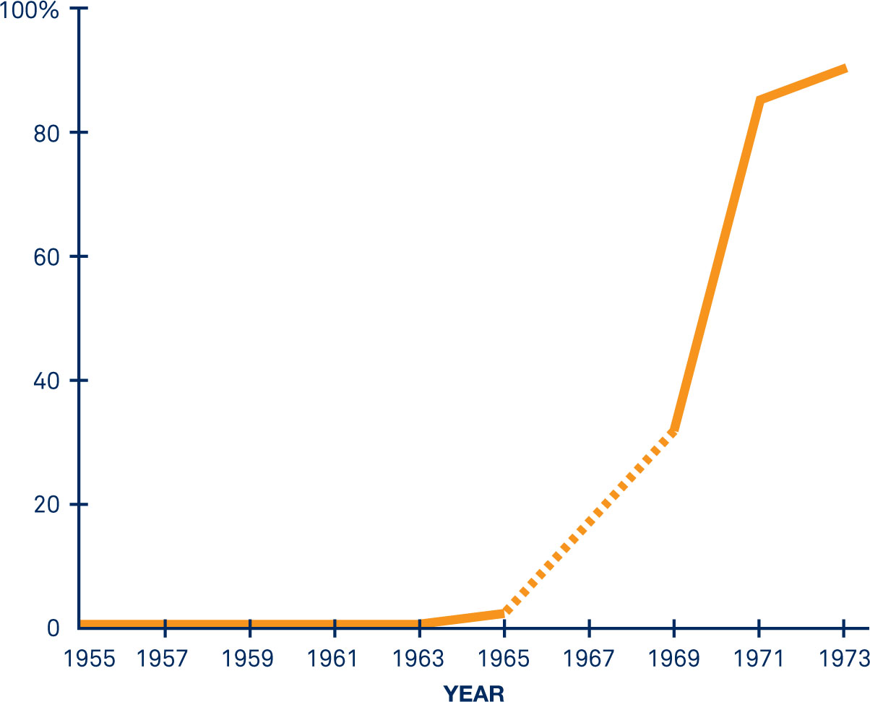
Clicker Question: Brown v. Board of Education
THE PERCENTAGE OF SOUTHERN BLACK SCHOOLCHILDREN ATTENDING SCHOOL WITH WHITES, 1955–73
Did Brown v. Board of Education desegregate public schools?
Yes
No
Notes:
Discussion:
There is some debate about this question, but it is useful to ask students and then get them to think about what caused southern schools to start desegregating in the mid-1960s.

Slide 16
The Rise of the Civil Rights Movement
Ending discrimination required more than the Brown decision
The civil rights movement built slowly but surely after Brown, culminating in the March on Washington in 1963
This required overcoming a collective action problem
Notes:
Discussion:
The text addresses the problem that individual participation in the civil rights movement made little sense, according to the rationality principle. After all, “Participation is costly in terms of time, and for civil rights marchers even one’s health or life was endangered” (p. 159). The text goes on to argue that individuals participated in civil rights marches because participation yielded an “experiential benefit.” It is useful to discuss this idea with students and ask them whether they buy the argument that participating in marches and protests and rallies (for instance, rallies for Bernie Sanders) yields an experiential benefit in their mind. If not, you might ask why they think civil rights marchers participated and why there is no mass social movement equivalent today. The text points out that we can reconcile the March on Washington with the collective action principle by understanding that sometimes people do things “because they like doing them—they feel free of guilt, they take pleasure in the activity for its own sake.”

Slide 17
Timeplot: The Civil Rights Movement

Slide 18
Timeplot: The Civil Rights Movement cont’d

Slide 19
School Desegregation
“Massive resistance” to desegregation was largely successful after Brown
After Little Rock, states used “pupil placement” laws to delay desegregation
The Civil Rights Act and later Court decisions, such as Swann, finally did begin to desegregate schools
In more recent rulings, the Court has sought to “disengage” from desegregation
Notes:
Discussion:
It is useful to point out to students that major action on desegregation and civil rights generally only happened after the civil rights movement and the March on Washington (1963). In the Swann v. Charlotte (1971) decision, the Court held that state-imposed desegregation could be imposed including busing of children long distances to integrate schools.

Slide 20
Discrimination in Employment
Title VII of the Civil Rights Act of 1964 outlaws job discrimination by all private and public employers
In Griggs v. Duke Power (1971), the Court put the burden on employers to show that an employment policy whose effect is discriminatory, even if discrimination was not the intent of the policy, is a “business necessity”

Slide 21
Ledbetter v. Goodyear (2007)
The Court ruled that a charge of discrimination must be brought within 180 days of the time the discrimination was alleged to have occurred
Congress overturned the Court’s decision by passing the Fair Pay Act in 2009
Notes:
Discussion/Activity:
One way to bring a consideration of gender discrimination up to the present is to discuss the Lilly Ledbetter case and law. In a 2007 case dealing with gender discrimination, the Supreme Court ruled that employers cannot be sued for pay discrimination under Title VII of the Civil Rights Act if the claims are based on decisions made more than 180 days earlier. Outrage in Congress about the 5–4 decision led to the Lilly Ledbetter Fair Pay Act of 2009, which amended Title VII of the Civil Rights Act to reset the 180-day clock every time a new discrimination-based paycheck is received. The case can be used to spark a discussion about how we might know or how we might prove whether gender discrimination is taking place. In addition, the example of the Ledbetter case highlights the policy principle: political outcomes are the products of individual preferences and institutional procedures.

Slide 22
Gender Discrimination
Seneca Falls Convention (1848)
Nineteenth Amendment (1920) grants women the right to vote in federal elections
Civil rights for women accelerates in the 1960s
ERA falls just short of ratification in 1982
The Burger Court applies intermediate scrutiny to gender discrimination cases
Notes:
Discussion:
Intermediate scrutiny is the test used by the Supreme Court in gender discrimination cases, which places the burden of proof partially on the government and partially on the challengers to show that the law in question is constitutional.

Slide 23
Discrimination against Latinos and Asian Americans
Latinos and Asian Americans are among the fastest-growing racial/ethnic groups
These groups have also organized to pursue civil rights:
Mendez v. Westminster (1947) was an important desegregation precedent prior to Brown
Lau v. Nichols (1974) required that students be taught in a language they understand

Slide 24
Status of Native Americans
The Constitution leaves the status of Native Americans unclear
Legislation in 1924 grants citizenship to all those born in the United States
The Indian Self-Determination and Education Assistance Act (1975) provides for greater autonomy
No state regulation of gambling (1987)

Slide 25
Immigration and Rights
Approximately one in eight persons living in the U.S. was born in another country
DREAM Act: 2014 executive order granting legal status to undocumented children or parents
This was arguably the most significant civil rights issue in the 2016 election campaign

Slide 26
Disabilities and Age
The Americans with Disabilities Act (1990) guarantees equal employment rights and access to businesses
Similar to the NAACP’s Legal Defense Fund, the disability movement founded the Disability Rights & Education Defense Fund

Slide 27
LGBTQ
The gay rights movement has become one of the most important contemporary flashpoints for civil rights:
“Don’t Ask, Don’t Tell” (repealed in 2010)
Romer v. Evans (1996) prohibits discrimination based on sexual orientation
Lawrence v. Texas (2003) overturns Bowers v. Hardwick
Transgender equality is the most important current fight
Notes:
Discussion:
When civil rights is discussed, students usually immediately think of the civil rights movement of the 1960s and African Americans in particular. But a discussion about discrimination against the LGBTQ communities is a good way to make it clear that civil rights are about more than race.

Slide 28
DOMA and Gay Marriage
U.S. v. Windsor (2013) ruled DOMA unconstitutional
Obergefell v. Hodges (2015) ruled that there is a right to marry for same-sex couples under the due process clause and the equal protection clause of the Fourteenth Amendment
Notes:
Discussion:
The issue of gay marriage in particular can spark good discussion because it cuts across a variety of other areas covered in this and previous chapters. There are federalism issues (should one state be allowed not to recognize a legal gay marriage from another state?), there are civil liberties issues (right to privacy and Bowers), and there are equal-protection issues (discrimination). A possible writing assignment or class discussion would be to ask students to imagine they are writing a brief for the Supreme Court in Obergefell v. Hodges. What constitutional arguments could they come up with on either side of this question?

Slide 29
Affirmative Action
A policy or program designed to redress historic injustices committed against specific groups by making special efforts to provide members of these groups with access to educational and employment opportunities
Also meant to encourage diversity in educational and employment settings

Slide 30
Regents of the University of California vs. Bakke (1978)
Allan Bakke, a white man, applied to UC Davis Medical School and was rejected
The school had reserved 16 of 100 seats that year for minority applicants
Bakke sued on the basis that his grades and test scores were better than those of some who were admitted

Slide 31
UC Regents v. Bakke (1978)
The Court ruled that UC Davis’s policy was unconstitutional because it maintained a quota and had a separate admissions policy for minority students
However, the Court said that taking race into account in admissions is constitutional if it serves a “compelling public purpose,” such as “achieving a diverse student body”

Slide 32
Gratz v. Bollinger (2003) Grutter v. Bollinger (2003)
In various cases, the Court seemed to weaken affirmative action but not deem it unconstitutional in the 25 years since Bakke
In 2003, the Court heard two cases, both from the University of Michigan, that seemed to uphold both sides of Bakke
Race cannot be a main criterion for admission
Race can be taken into account
Notes:
Discussion/Audio:
It is useful to have students listen to the opinion announcements in both Gratz and Grutter, as the Court outlines the distinction between the two different affirmative action systems in place at the University of Michigan.
The opinion announcement can be found here for Gratz v. Bollinger: http://www.oyez.org/cases/2000-2009/2002/2002_02_516.
The opinion announcement can be found here for Grutter v. Bollinger: http://www.oyez.org/cases/2000-2009/2002/2002_02_241.
After listening to both opinions, ask students if they think the two decisions make sense together. Then ask students if they think universities have clear guidance from these cases on how they could tailor an affirmative action policy. The Supreme Court recently passed on an opportunity to substantially revise its view on the constitutionality of affirmative action in Fisher v. University of Texas.

Slide 33
Affirmative Action and “Preferential Treatment”
Proposition 209, on the California ballot in 1996, sought to ban “preferential treatment” for minorities by state and local government agencies; it passed with 54 percent of the vote
In a 1997 vote in Houston, however, 55 percent voted to support “affirmative action”
What we call “affirmative action” matters

Slide 34
Clicker Question: Review
Affirmative action is
unconstitutional in any form.
constitutional as long as race is not too big a factor.
required by the equal protection clause.
required by the due process clause.
Notes:
Answer: B. constitutional as long as race is not too big a factor.

Slide 35
Clicker Question: Review (Answer)
Affirmative action is
unconstitutional in any form.
constitutional as long as race is not too big a factor.
required by the equal protection clause.
required by the due process clause.
Notes:
Answer: B. constitutional as long as race is not too big a factor.

Slide 36
Limiting and Regulating Collective Action
Civil liberties and civil rights have both expanded over the past century
Expansion of civil rights has allowed more to take part in collective decision making and has imposed restrictions on the sorts of decisions that can be reached
Institutions help alleviate collective action, but they are limited and regulated by civil liberties and civil rights

Slide 37
Additional Information
Following this slide, you will find additional images, figures, and tables from the textbook.

Slide 38
Transgender Rights and Policy
Notes:
An inclusive restroom that people of any gender identity may use.

Slide 39
Analyzing the Evidence: Advocacy for Marginalized Groups
Notes:
Historically, women, people of color, and low-income people have faced institutional barriers to participating in collective political processes. When formal avenues of participation, such as voting, are closed, these groups have turned to advocacy organizations as a means to offset this paucity of legislative representation. Indeed, for many years, national advocacy organizations offered some of the only political voice and visibility available to groups such as African Americans in the South and women of all races, who were denied formal voting rights until well into the twentieth century. Long before most women could vote, for example, the National American Woman Suffrage Association mounted protests and lobbied legislators.
The extension of certain formally recognized civil rights to women, people of color, and low-income people has not ended the need for advocacy organizations, however, and the second half of the twentieth century witnessed an explosion in the number of organizations representing these groups. By speaking for marginalized populations on the national political stage, such organizations provide a crucial bridge between the often unheard political voices of underrepresented groups and government institutions, helping reduce racial, gender, and sex-based discrimination and create new resources and opportunities for low-income people.

Slide 40
Analyzing the Evidence: Representation for Groups
Notes:
But while the proliferation of advocacy organizations is a striking feature of contemporary American politics, the extent to which these groups have leveled the representational playing field is unclear. First, the growth in the number of social and economic justice organizations has been vastly outpaced by increased numbers of business and professional organizations, and organizations that represent marginalized groups constitute only a modest proportion of the larger interest group universe.
Advocacy organizations that represent women, people of color, and low-income people have also been criticized for focusing on the needs of the more advantaged members of the marginalized constituencies. Research confirms the validity of this criticism: a survey of 286 organizations found that women’s and African American groups, for example, were much more active on affirmative action in higher education than they were on the welfare reform legislation that passed in 1996, which had major implications for low-income women and people of color. Although advocacy organizations can fall short, many take deliberate steps to more effectively represent disadvantaged constituents.

Slide 41
